Slide 1
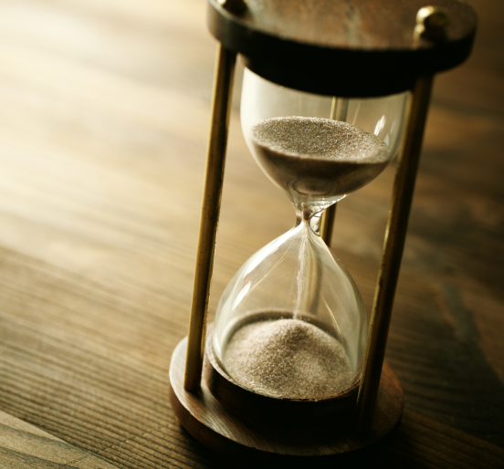
La Naturaleza Divina- Paciencia
2 Ped 1: 3-11
Notes:
2 Peter 1:3-11 KJV According as his divine power hath given unto us all things that pertain unto life and godliness, through the knowledge of him that hath called us to glory and virtue: (4) Whereby are given unto us exceeding great and precious promises: that by these ye might be partakers of the divine nature, having escaped the corruption that is in the world through lust. (5) And beside this, giving all diligence, add to your faith virtue; and to virtue knowledge; (6) And to knowledge temperance; and to temperance patience; and to patience godliness; (7) And to godliness brotherly kindness; and to brotherly kindness charity. (8) For if these things be in you, and abound, they make you that ye shall neither be barren nor unfruitful in the knowledge of our Lord Jesus Christ. (9) But he that lacketh these things is blind, and cannot see afar off, and hath forgotten that he was purged from his old sins. (10) Wherefore the rather, brethren, give diligence to make your calling and election sure: for if ye do these things, ye shall never fall: (11) For so an entrance shall be ministered unto you abundantly into the everlasting kingdom of our Lord and Saviour Jesus Christ.

Slide 2

Introducción
Paciencia no es esperar pasivamente. Paciencia es actividad aceptada de el proseso requerido para alcanzar la meta y los sueños
La paciencia de Job
  Stg 5:11
Resistencia
Firme
  Hebreos 3:14
Sin ignorar
  Condiciones
  Situaciones
  Pero no desertar

Slide 3
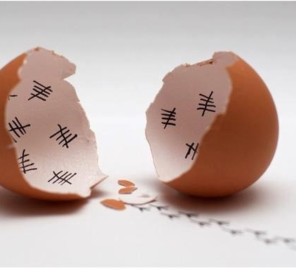
Firme en los juicios
El sufrir obra en la firmeza
  Romanos 5: 3
Fiel hasta la muerte
  Apocalipsis 2:10
Soportar Penas
  1 Pedro 2: 19-23
Firme en la fe resistiendo al diablo,
  1 Pedro 5: 8-9

Slide 4

Paciente en el servicio
1 Cor 15:58
Prosegir Hacia el objetivo
  Filipenses 3:14
Sin descuidar
  Hebreos 2: 3
Sin abandonar
  Hebreos 10:25
La Fortaleza de todo guerrero son esas dos– Tiempo y Paciencia

Slide 5

Paciente con otros
Un momento de paciencia en un momento de ira te salvará de cientos de momentos de lamentaciones
El débil
  Romanos 15:1-4
Lleva su carga cuando peca
  Gálatas 6: 1-2
El amor sufre mucho
  1 Corintios 13: 4

Slide 6
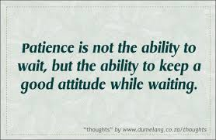
Esperar Pacientemente
Santiago 5: 7
Cosechar si no desmayamos
  Gálatas 6: 9
Esperar a la redención
  Romanos 8: 23-25
Paciencia en la esperanza
  1 Tesalonicenses 1: 3
Paciencia no es la habilidad de esperar, pero si la habilidad de tener buena actitud mientras esperamos.

Slide 7
La Divina Naturaleza –
Paciencia
2 Pedro 1: 3-11

