Slide 1
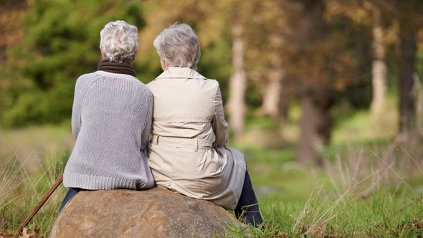
Buenos Amigos

Slide 2
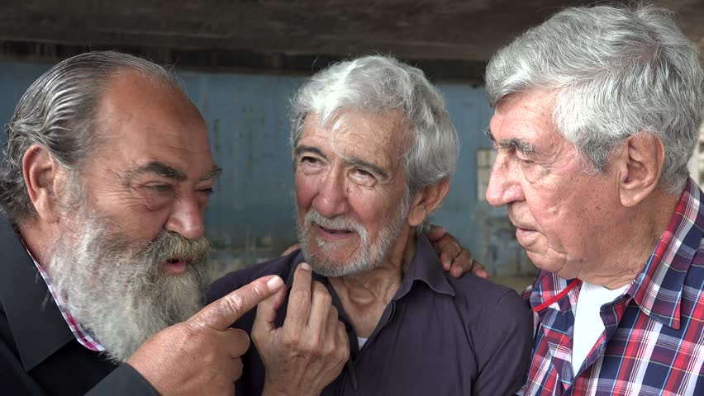
La Amistad es una Calle de Doble Sentido.
Prov 18:24
El hombre que tiene amigos ha de mostrarse amigo;
Y amigo hay más unido que un hermano.

Slide 3
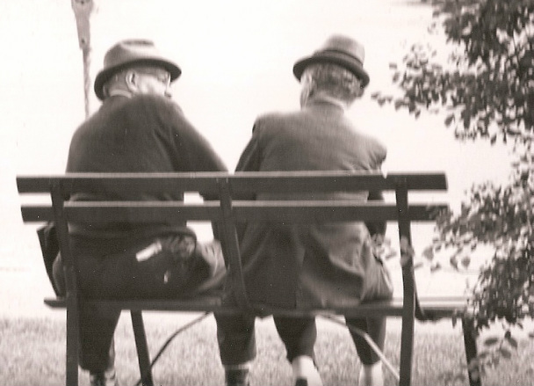
La Amistad es a Través de Sobra y Escases
Prov 17:17
En todo tiempo ama el amigo,
Y es como un hermano en tiempo de angustia.

Slide 4
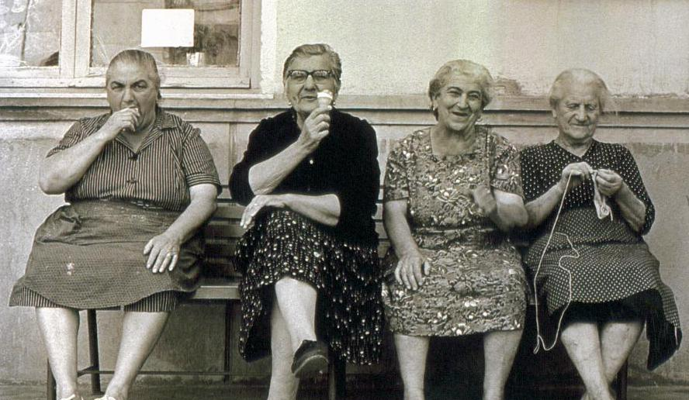
La Amistad Está en lo que Necesita ser Dicho.
Prov 27:5-6 Mejor es reprensión manifiesta
Que amor oculto. ⁶ Fieles son las heridas del que ama;
Pero importunos los besos del que aborrece.
Prov 27:9 El unguento y el perfume alegran el corazón,
Y el cordial consejo del amigo, al hombre.
Prov 27:17 Hierro con hierro se aguza;
Y así el hombre aguza el rostro de su amigo.

Slide 5
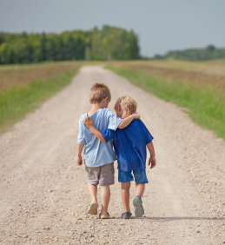
La Amistad es una Mejor Forma de Vida
Ecc 4:9-12 ⁹ Mejores son dos que uno; porque tienen mejor paga de su trabajo.
¹⁰ Porque si cayeren, el uno levantará a su compañero; pero !!ay del solo! que cuando cayere, no habrá segundo que lo levante.
¹¹ También si dos durmieren juntos, se calentarán mutuamente; mas ¿cómo se calentará uno solo?
¹² Y si alguno prevaleciere contra uno, dos le resistirán; y cordón de tres dobleces no se rompe pronto.

Slide 6
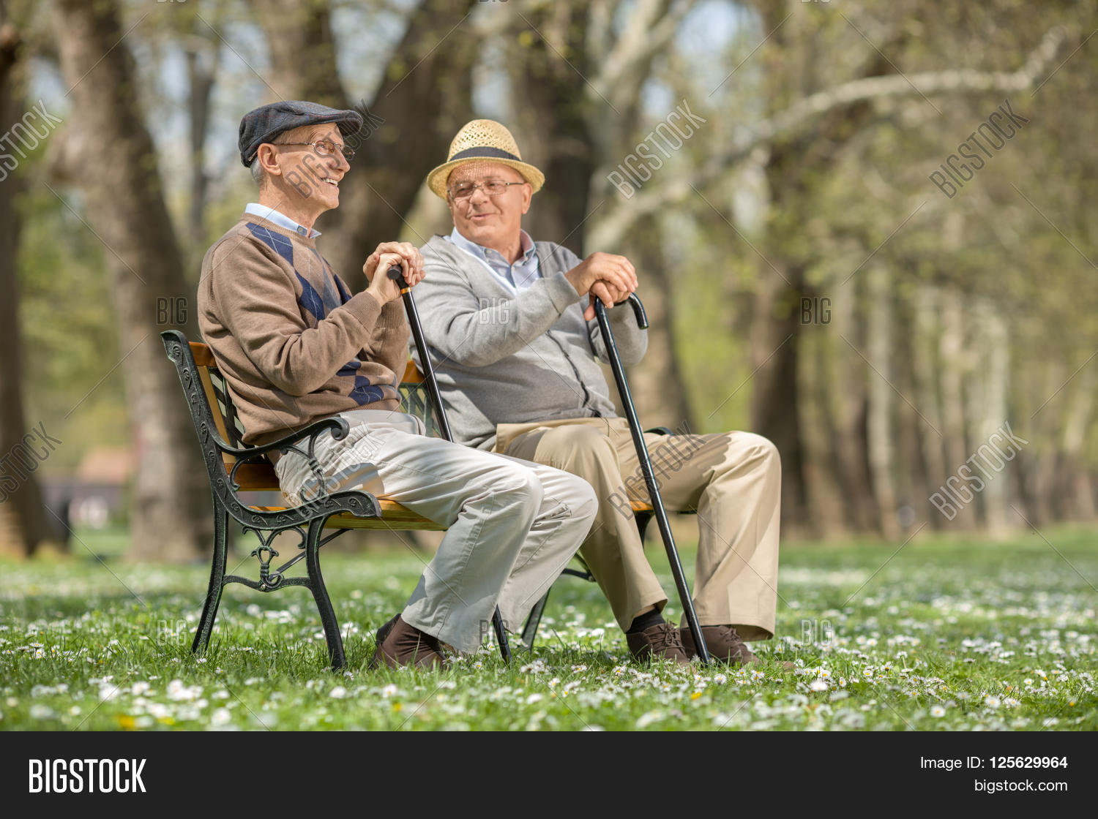
Cosas que Debes Evitar con un Amigo
No pedir dinero prestado
  Proverbios 6: 1-5
  Proverbios 17:18
No te olvides de un amigo
  Proverbios 27:10
No seas una plaga
  Proverbios 27:14
Evitar los chismes
  Proverbios 16:28; 17: 9
Amistad con el mundo
  Santiago 4: 4
Notes:
Proverbs 6:1-5 KJV My son, if thou be surety for thy friend, if thou hast stricken thy hand with a stranger, (2) Thou art snared with the words of thy mouth, thou art taken with the words of thy mouth. (3) Do this now, my son, and deliver thyself, when thou art come into the hand of thy friend; go, humble thyself, and make sure thy friend. (4) Give not sleep to thine eyes, nor slumber to thine eyelids. (5) Deliver thyself as a roe from the hand of the hunter, and as a bird from the hand of the fowler.
Proverbs 17:18 KJV A man void of understanding striketh hands, and becometh surety in the presence of his friend.
Proverbs 27:10 KJV Thine own friend, and thy father's friend, forsake not; neither go into thy brother's house in the day of thy calamity: for better is a neighbour that is near than a brother far off.
Proverbs 27:14 KJV He that blesseth his friend with a loud voice, rising early in the morning, it shall be counted a curse to him.
James 4:4 KJV Ye adulterers and adulteresses, know ye not that the friendship of the world is enmity with God? whosoever therefore will be a friend of the world is the enemy of God.

Slide 7
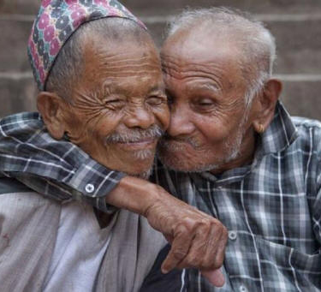
Lecciones de la Amistad
Oración
  Lucas 11: 5-10
Más que un discípulo
  Lucas 11:11
Visitantes en problemas
  Hechos 24:22
Un amigo y amante
  Cantares 5:16
Notes:
Luke 11:5-10 KJV And he said unto them, Which of you shall have a friend, and shall go unto him at midnight, and say unto him, Friend, lend me three loaves; (6) For a friend of mine in his journey is come to me, and I have nothing to set before him? (7) And he from within shall answer and say, Trouble me not: the door is now shut, and my children are with me in bed; I cannot rise and give thee. (8) I say unto you, Though he will not rise and give him, because he is his friend, yet because of his importunity he will rise and give him as many as he needeth. (9) And I say unto you, Ask, and it shall be given you; seek, and ye shall find; knock, and it shall be opened unto you. (10) For every one that asketh receiveth; and he that seeketh findeth; and to him that knocketh it shall be opened.
John 11:11 KJV These things said he: and after that he saith unto them, Our friend Lazarus sleepeth; but I go, that I may awake him out of sleep.
Acts 24:22-23 NIV Then Felix, who was well acquainted with the Way, adjourned the proceedings. "When Lysias the commander comes," he said, "I will decide your case." (23) He ordered the centurion to keep Paul under guard but to give him some freedom and permit his friends to take care of his needs.
Song of Solomon 5:16 NIV (16) His mouth is sweetness itself; he is altogether lovely. This is my beloved, this is my friend, daughters of Jerusalem.

Slide 8
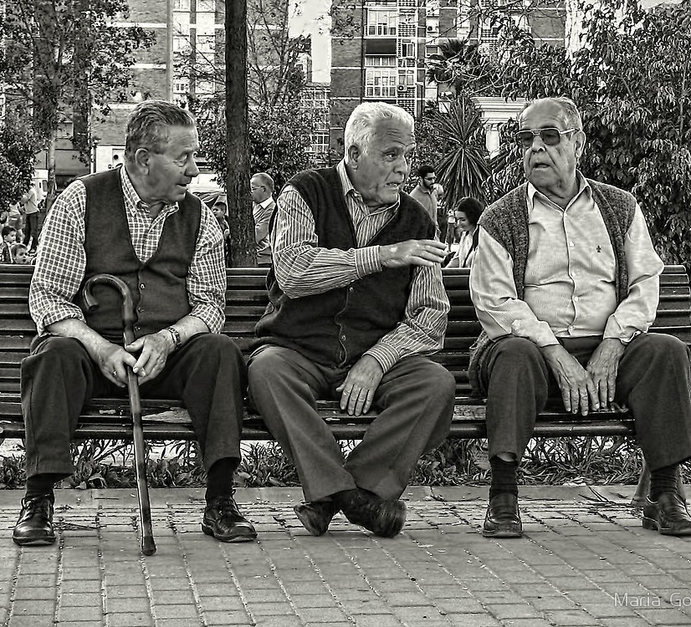
A Veces un Amigo Puede Estar Equivocado
Job 2:11-13
Job 42:7-11
Notes:
Job 2:11-13 NIV When Job's three friends, Eliphaz the Temanite, Bildad the Shuhite and Zophar the Naamathite, heard about all the troubles that had come upon him, they set out from their homes and met together by agreement to go and sympathize with him and comfort him. (12) When they saw him from a distance, they could hardly recognize him; they began to weep aloud, and they tore their robes and sprinkled dust on their heads. (13) Then they sat on the ground with him for seven days and seven nights. No one said a word to him, because they saw how great his suffering was.
Job 42:7-11 NIV After the LORD had said these things to Job, he said to Eliphaz the Temanite, "I am angry with you and your two friends, because you have not spoken the truth about me, as my servant Jobhas. (8) So now take seven bulls and seven rams and go to my servant Job and sacrifice a burnt offering for yourselves. My servant Jobwill pray for you, and I will accept his prayer and not deal with you according to your folly. You have not spoken the truth about me, as my servant Jobhas." (9) So Eliphaz the Temanite, Bildad the Shuhite and Zophar the Naamathite did what the LORD told them; and the LORD accepted Job's prayer. (10) After Job had prayed for his friends, the LORD restored his fortunes and gave him twice as much as he had before. (11) All his brothers and sisters and everyone who had known him before came and ate with him in his house. They comforted and consoled him over all the trouble the LORD had brought on him, and each one gave him a piece of silver and a gold ring.

Slide 9

El Amor Más Grande
Jn 15:12-15 ¹² Este es mi mandamiento: Que os améis unos a otros, como yo os he amado.
¹³ Nadie tiene mayor amor que este, que uno ponga su vida por sus amigos.
¹⁴ Vosotros sois mis amigos, si hacéis lo que yo os mando.
¹⁵ Ya no os llamaré siervos, porque el siervo no sabe lo que hace su señor; pero os he llamado amigos, porque todas las cosas que oí de mi Padre, os las he dado a conocer.
UN VERDADERO AMIGO CONOCE TODAS TUS HISTORIAS.
EL MEJOR TE AYUDARA A ESCRIBIRLAS

