Slide 1
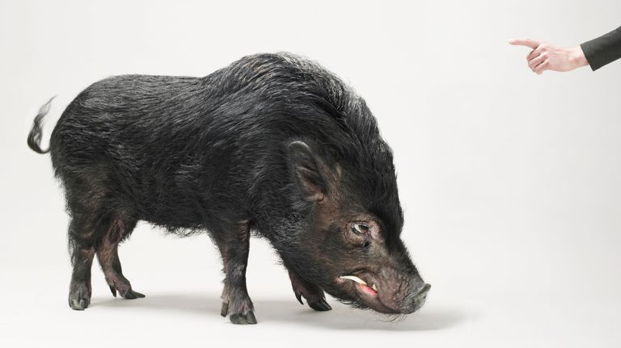
Asociados de Cerdos y Perros
Notes:
Leviticus 11:7-8 KJV And the swine, though he divide the hoof, and be clovenfooted, yet he cheweth not the cud; he is unclean to you. (8) Of their flesh shall ye not eat, and their carcase shall ye not touch; they are unclean to you.

Slide 2
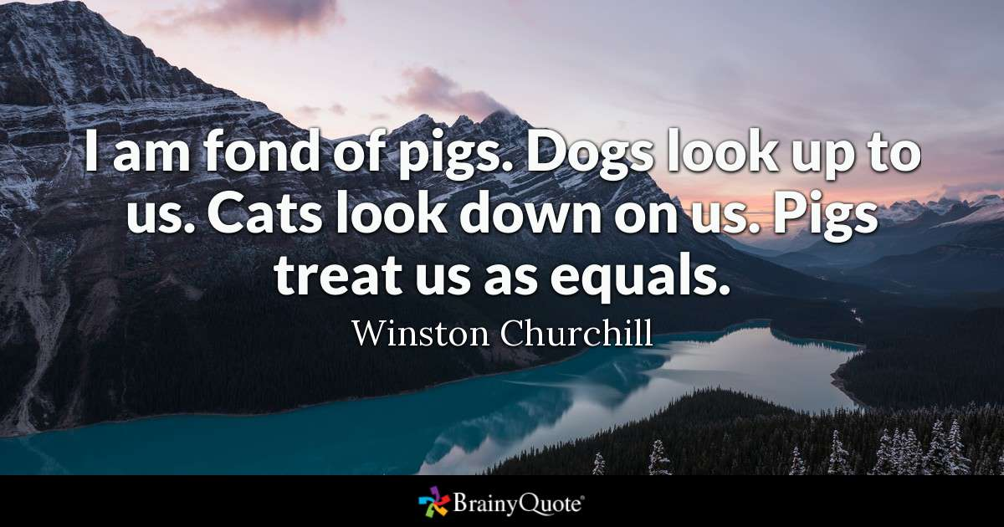
ME GUSTAN LOS CERDOS. LOS PERROS NOS MIRAN HACIA ARRIBA. LOS GATOS NOS MIRAN HACIA ABAJO . LOS CERDOS NOS TRATAN COMO IGUALES.
Notes:
Leviticus 11:7-8 KJV And the swine, though he divide the hoof, and be clovenfooted, yet he cheweth not the cud; he is unclean to you. (8) Of their flesh shall ye not eat, and their carcase shall ye not touch; they are unclean to you.

Slide 3
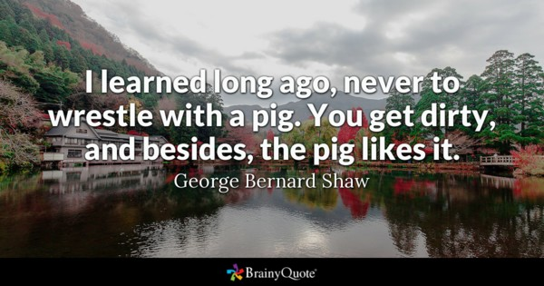
APRENDÍ HACE MUCHO TIEMPO, A NUNCA LUCHAR CON UN CERDO. PORQUE ACABAS SUCIO, Y ADEMÁS, AL CERDO LE GUSTA.

Slide 4
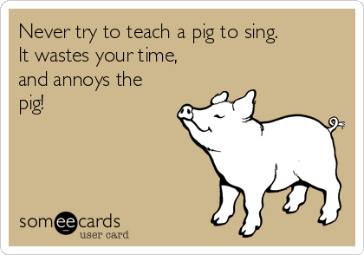
NUNCA INTENTE ENSEÑAR A UN CERDO A CANTAR. ES TIEMPO PERDIDO, Y MOLESTA AL CERDO

Slide 5
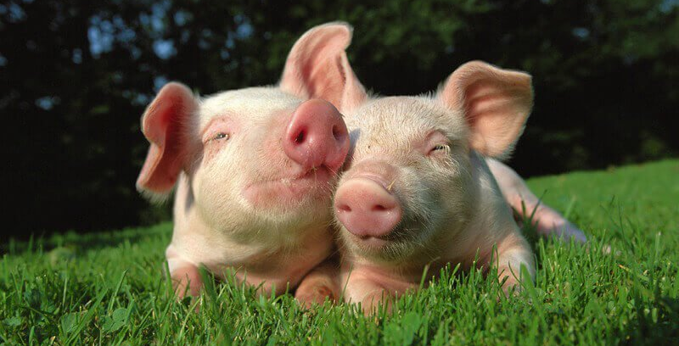

Slide 6
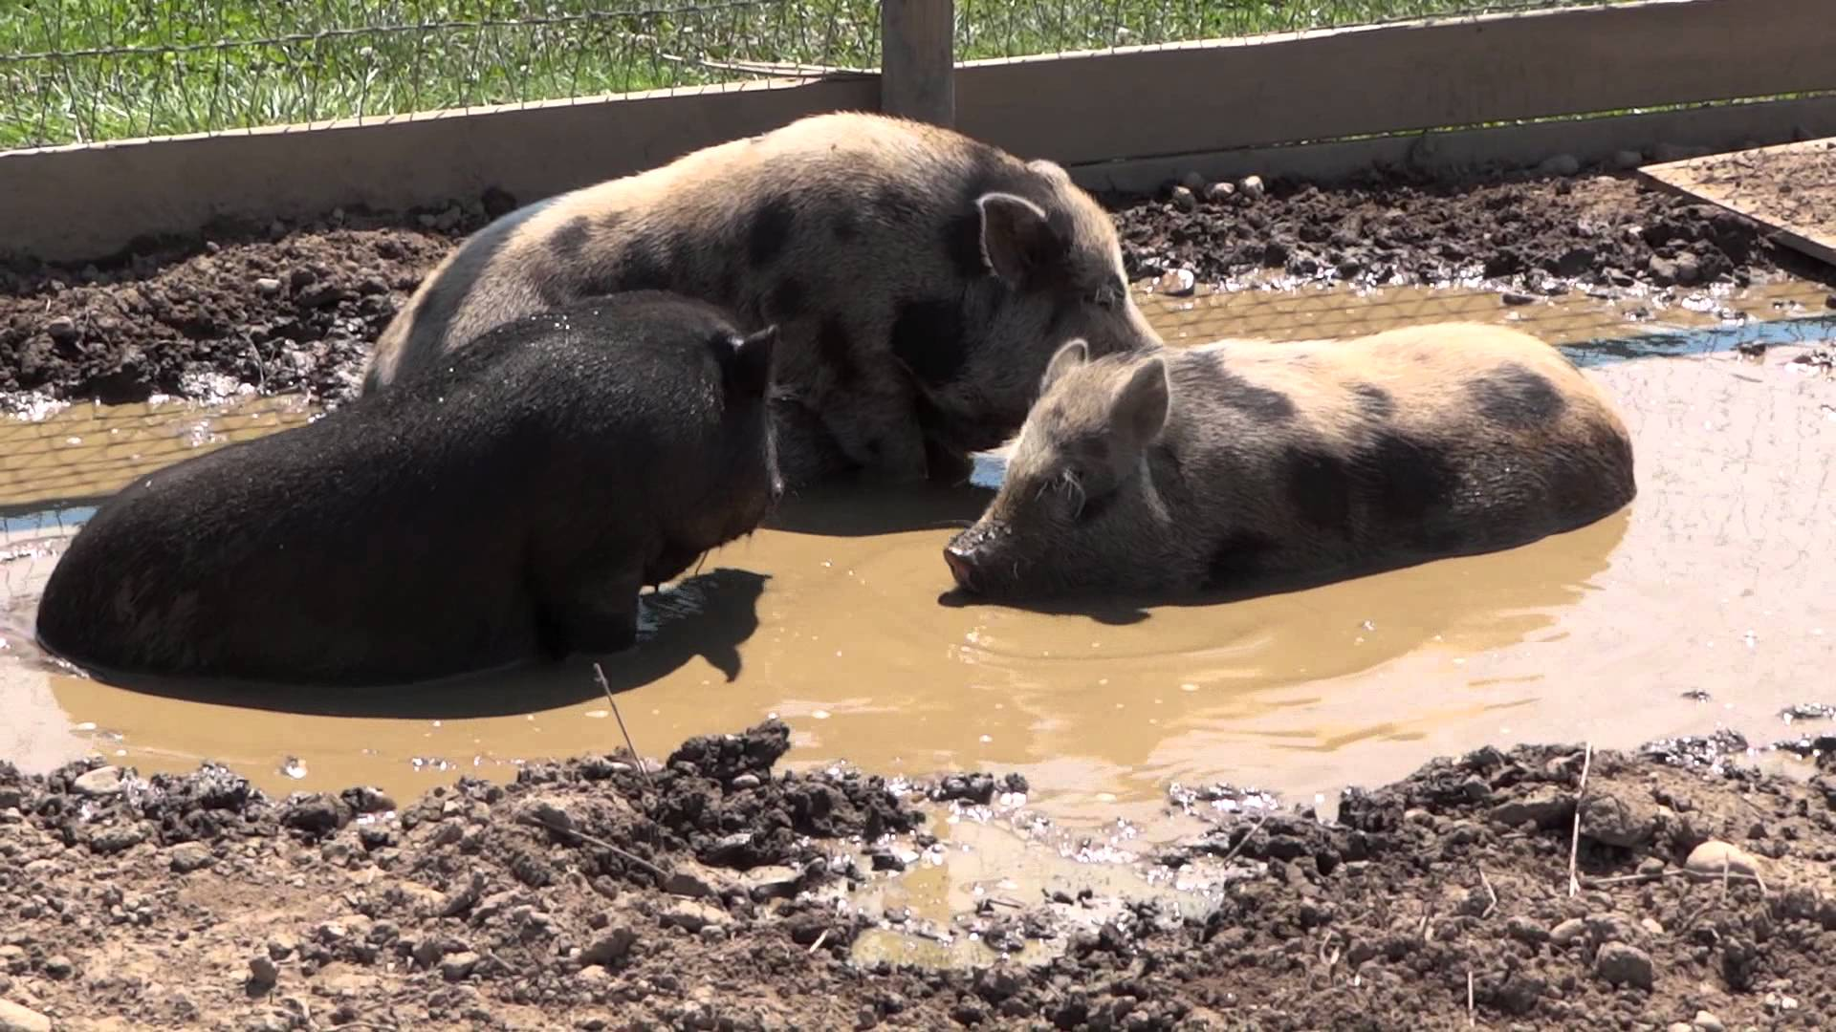

Slide 7
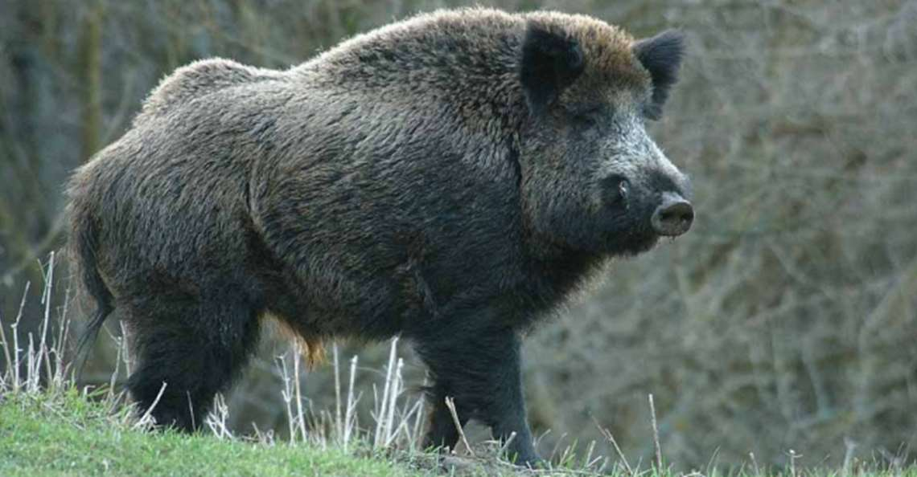

Slide 8
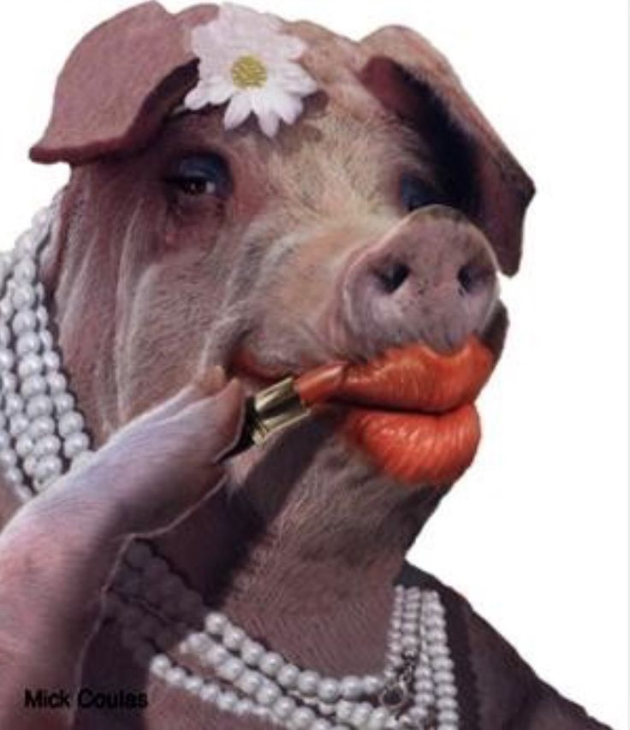
Los cerdos no se portan bien en la Biblia
Proverbios 11:22
Isaías 66: 1-4
Mateo 7: 6
Lucas 15: 11-32
2 Pedro 2: 20-22
Notes:
Proverbs 11:22 KJV As a jewel of gold in a swine's snout, so is a fair woman which is without discretion.
Isaiah 66:1-4 KJV Thus saith the LORD, The heaven is my throne, and the earth is my footstool: where is the house that ye build unto me? and where is the place of my rest? (2) For all those things hath mine hand made, and all those things have been, saith the LORD: but to this man will I look, even to him that is poor and of a contrite spirit, and trembleth at my word. (3) He that killeth an ox is as if he slew a man; he that sacrificeth a lamb, as if he cut off a dog's neck; he that offereth an oblation, as if he offered swine's blood; he that burneth incense, as if he blessed an idol. Yea, they have chosen their own ways, and their soul delighteth in their abominations. (4) I also will choose their delusions, and will bring their fears upon them; because when I called, none did answer; when I spake, they did not hear: but they did evil before mine eyes, and chose that in which I delighted not.
Matthew 7:6 KJV Give not that which is holy unto the dogs, neither cast ye your pearls before swine, lest they trample them under their feet, and turn again and rend you.
Luke 15:13-17 KJV And not many days after the younger son gathered all together, and took his journey into a far country, and there wasted his substance with riotous living. (14) And when he had spent all, there arose a mighty famine in that land; and he began to be in want. (15) And he went and joined himself to a citizen of that country; and he sent him into his fields to feed swine. (16) And he would fain have filled his belly with the husks that the swine did eat: and no man gave unto him. (17) And when he came to himself, he said, How many hired servants of my father's have bread enough and to spare, and I perish with hunger!
2 Peter 2:20-22 KJV For if after they have escaped the pollutions of the world through the knowledge of the Lord and Saviour Jesus Christ, they are again entangled therein, and overcome, the latter end is worse with them than the beginning. (21) For it had been better for them not to have known the way of righteousness, than, after they have known it, to turn from the holy commandment delivered unto them. (22) But it is happened unto them according to the true proverb, The dog is turned to his own vomit again; and the sow that was washed to her wallowing in the mire.

Slide 9
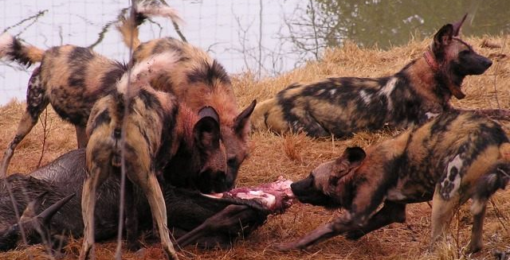

Slide 10
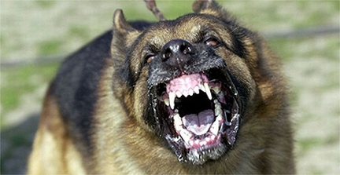

Slide 11
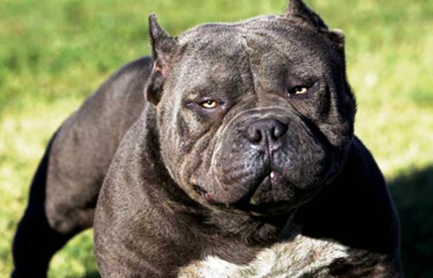
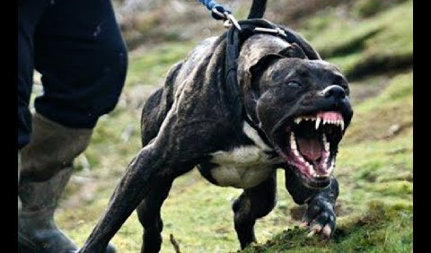

Slide 12


Slide 13
A los perros no les va bien tampoco
Deuteronomio 23:18
Salmos 22:16, 20
Isaías 56: 8-12
Jeremías 15: 3
Mateo 15: 21-28
Filipenses 3: 2
Apocalipsis 22: 14-15
Notes:
Deuteronomy 23:17-18 KJV There shall be no whore of the daughters of Israel, nor a sodomite of the sons of Israel. (18) Thou shalt not bring the hire of a whore, or the price of a dog, into the house of the LORD thy God for any vow: for even both these are abomination unto the LORD thy God.
Psalms 22:16 KJV For dogs have compassed me: the assembly of the wicked have inclosed me: they pierced my hands and my feet.
Psalms 22:20 KJV Deliver my soul from the sword; my darling from the power of the dog.
Isaiah 56:8-12 KJV The Lord GOD which gathereth the outcasts of Israel saith, Yet will I gather others to him, beside those that are gathered unto him. (9) All ye beasts of the field, come to devour, yea, all ye beasts in the forest. (10) His watchmen are blind: they are all ignorant, they are all dumb dogs, they cannot bark; sleeping, lying down, loving to slumber. (11) Yea, they are greedy dogs which can never have enough, and they are shepherds that cannot understand: they all look to their own way, every one for his gain, from his quarter. (12) Come ye, say they, I will fetch wine, and we will fill ourselves with strong drink; and to morrow shall be as this day, and much more abundant.
Jeremiah 15:3 KJV And I will appoint over them four kinds, saith the LORD: the sword to slay, and the dogs to tear, and the fowls of the heaven, and the beasts of the earth, to devour and destroy.
Matthew 15:21-28 KJV Then Jesus went thence, and departed into the coasts of Tyre and Sidon. (22) And, behold, a woman of Canaan came out of the same coasts, and cried unto him, saying, Have mercy on me, O Lord, thou Son of David; my daughter is grievously vexed with a devil. (23) But he answered her not a word. And his disciples came and besought him, saying, Send her away; for she crieth after us. (24) But he answered and said, I am not sent but unto the lost sheep of the house of Israel. (25) Then came she and worshipped him, saying, Lord, help me. (26) But he answered and said, It is not meet to take the children's bread, and to cast it to dogs. (27) And she said, Truth, Lord: yet the dogs eat of the crumbs which fall from their masters' table. (28) Then Jesus answered and said unto her, O woman, great is thy faith: be it unto thee even as thou wilt. And her daughter was made whole from that very hour.
Philippians 3:2 KJV Beware of dogs, beware of evil workers, beware of the concision.
Revelation 22:14-15 KJV Blessed are they that do his commandments, that they may have right to the tree of life, and may enter in through the gates into the city. (15) For without are dogs, and sorcerers, and whoremongers, and murderers, and idolaters, and whosoever loveth and maketh a lie.

Slide 14

UNA MEJOR COMPRENSION
Qué repugnante es el mal
La importancia de la Fidelidad
Hebreos 11
La necesidad de volver a casa
Lucas 15
Si no somos cristianos, existe la necesidad de obedecer el Evangelio y llegar a la nueva vida.
Romanos 6

