Slide 1
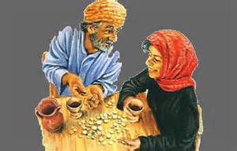
Ananias y
Safira
Hch 5:1-11
Notes:
Acts 5:1-11 KJV But a certain man named Ananias, with Sapphira his wife, sold a possession, (2) And kept back part of the price, his wife also being privy to it, and brought a certain part, and laid it at the apostles' feet. (3) But Peter said, Ananias, why hath Satan filled thine heart to lie to the Holy Ghost, and to keep back part of the price of the land? (4) Whiles it remained, was it not thine own? and after it was sold, was it not in thine own power? why hast thou conceived this thing in thine heart? thou hast not lied unto men, but unto God. (5) And Ananias hearing these words fell down, and gave up the ghost: and great fear came on all them that heard these things. (6) And the young men arose, wound him up, and carried him out, and buried him. (7) And it was about the space of three hours after, when his wife, not knowing what was done, came in. (8) And Peter answered unto her, Tell me whether ye sold the land for so much? And she said, Yea, for so much. (9) Then Peter said unto her, How is it that ye have agreed together to tempt the Spirit of the Lord? behold, the feet of them which have buried thy husband are at the door, and shall carry thee out. (10) Then fell she down straightway at his feet, and yielded up the ghost: and the young men came in, and found her dead, and, carrying her forth, buried her by her husband. (11) And great fear came upon all the church, and upon as many as heard these things.

Slide 2

El pecado Fue Una Mentira
Quizás la motivación fue la hipocresía
Quizás no podrían darse el lujo de darlo todo
  Ciertamente no tenían que darlo todo
  Querían la reputación de ser tan generosos como los demás.
¿Qué más podemos aprender aquí?
Notes:
Acts 5:1-11 KJV But a certain man named Ananias, with Sapphira his wife, sold a possession, (2) And kept back part of the price, his wife also being privy to it, and brought a certain part, and laid it at the apostles' feet. (3) But Peter said, Ananias, why hath Satan filled thine heart to lie to the Holy Ghost, and to keep back part of the price of the land? (4) Whiles it remained, was it not thine own? and after it was sold, was it not in thine own power? why hast thou conceived this thing in thine heart? thou hast not lied unto men, but unto God. (5) And Ananias hearing these words fell down, and gave up the ghost: and great fear came on all them that heard these things. (6) And the young men arose, wound him up, and carried him out, and buried him. (7) And it was about the space of three hours after, when his wife, not knowing what was done, came in. (8) And Peter answered unto her, Tell me whether ye sold the land for so much? And she said, Yea, for so much. (9) Then Peter said unto her, How is it that ye have agreed together to tempt the Spirit of the Lord? behold, the feet of them which have buried thy husband are at the door, and shall carry thee out. (10) Then fell she down straightway at his feet, and yielded up the ghost: and the young men came in, and found her dead, and, carrying her forth, buried her by her husband. (11) And great fear came upon all the church, and upon as many as heard these things.

Slide 3
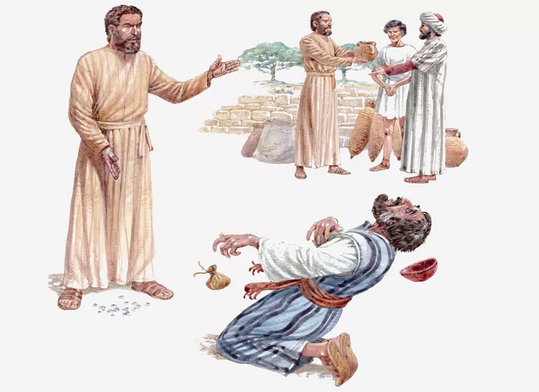
Qué Hacer Con Nuestro Dinero y Posesiones
Apoya nuestras necesidades
Compartir con otros
Mateo 13:46
San Marcos 10: 21-22
Efesios 4:28
Hay lugar para la generosidad
  Juan 12: 3-8
Hay un limite
  1 Corintios 13: 3
Considere el contraste con Bernabé
Notes:
Matthew 13:46 KJV Who, when he had found one pearl of great price, went and sold all that he had, and bought it.
Mark 10:21-22 KJV Then Jesus beholding him loved him, and said unto him, One thing thou lackest: go thy way, sell whatsoever thou hast, and give to the poor, and thou shalt have treasure in heaven: and come, take up the cross, and follow me. (22) And he was sad at that saying, and went away grieved: for he had great possessions.
Ephesians 4:28 KJV Let him that stole steal no more: but rather let him labour, working with his hands the thing which is good, that he may have to give to him that needeth.
Galatians 6:9-10 KJV And let us not be weary in well doing: for in due season we shall reap, if we faint not. (10) As we have therefore opportunity, let us do good unto all men, especially unto them who are of the household of faith.
John 12:3-8 KJV Then took Mary a pound of ointment of spikenard, very costly, and anointed the feet of Jesus, and wiped his feet with her hair: and the house was filled with the odour of the ointment. (4) Then saith one of his disciples, Judas Iscariot, Simon's son, which should betray him, (5) Why was not this ointment sold for three hundred pence, and given to the poor? (6) This he said, not that he cared for the poor; but because he was a thief, and had the bag, and bare what was put therein. (7) Then said Jesus, Let her alone: against the day of my burying hath she kept this. (8) For the poor always ye have with you; but me ye have not always.
1 Corinthians 13:3 KJV And though I bestow all my goods to feed the poor, and though I give my body to be burned, and have not charity, it profiteth me nothing.
Acts 5:1-11 KJV But a certain man named Ananias, with Sapphira his wife, sold a possession, (2) And kept back part of the price, his wife also being privy to it, and brought a certain part, and laid it at the apostles' feet. (3) But Peter said, Ananias, why hath Satan filled thine heart to lie to the Holy Ghost, and to keep back part of the price of the land? (4) Whiles it remained, was it not thine own? and after it was sold, was it not in thine own power? why hast thou conceived this thing in thine heart? thou hast not lied unto men, but unto God. (5) And Ananias hearing these words fell down, and gave up the ghost: and great fear came on all them that heard these things. (6) And the young men arose, wound him up, and carried him out, and buried him. (7) And it was about the space of three hours after, when his wife, not knowing what was done, came in. (8) And Peter answered unto her, Tell me whether ye sold the land for so much? And she said, Yea, for so much. (9) Then Peter said unto her, How is it that ye have agreed together to tempt the Spirit of the Lord? behold, the feet of them which have buried thy husband are at the door, and shall carry thee out. (10) Then fell she down straightway at his feet, and yielded up the ghost: and the young men came in, and found her dead, and, carrying her forth, buried her by her husband. (11) And great fear came upon all the church, and upon as many as heard these things.
Acts 4:32-37 KJV And the multitude of them that believed were of one heart and of one soul: neither said any of them that ought of the things which he possessed was his own; but they had all things common. (33) And with great power gave the apostles witness of the resurrection of the Lord Jesus: and great grace was upon them all. (34) Neither was there any among them that lacked: for as many as were possessors of lands or houses sold them, and brought the prices of the things that were sold, (35) And laid them down at the apostles' feet: and distribution was made unto every man according as he had need. (36) And Joses, who by the apostles was surnamed Barnabas, (which is, being interpreted, The son of consolation,) a Levite, and of the country of Cyprus, (37) Having land, sold it, and brought the money, and laid it at the apostles' feet.

Slide 4
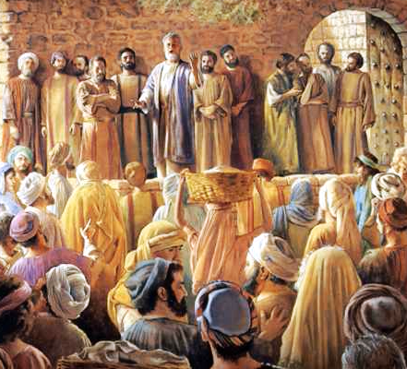
Los Apóstoles de Jesús Deben Ser Respetados
Eran líderes con autoridad
Judas 1:17
Efesios 3: 3-5
Efesios 2: 19-22
1 Corintios 12:28
Hechos 8:18
San Mateo 19:28
Mateo 18:18
1 Tesalonicenses 2:13
Notes:
Jude 1:17 KJV But, beloved, remember ye the words which were spoken before of the apostles of our Lord Jesus Christ;
Ephesians 3:3-5 KJV How that by revelation he made known unto me the mystery; (as I wrote afore in few words, (4) Whereby, when ye read, ye may understand my knowledge in the mystery of Christ) (5) Which in other ages was not made known unto the sons of men, as it is now revealed unto his holy apostles and prophets by the Spirit;
Ephesians 2:19-22 KJV Now therefore ye are no more strangers and foreigners, but fellowcitizens with the saints, and of the household of God; (20) And are built upon the foundation of the apostles and prophets, Jesus Christ himself being the chief corner stone; (21) In whom all the building fitly framed together groweth unto an holy temple in the Lord: (22) In whom ye also are builded together for an habitation of God through the Spirit.
1 Corinthians 12:28 KJV And God hath set some in the church, first apostles, secondarily prophets, thirdly teachers, after that miracles, then gifts of healings, helps, governments, diversities of tongues.
Acts 8:18 KJV And when Simon saw that through laying on of the apostles' hands the Holy Ghost was given, he offered them money,
Matthew 19:28 KJV And Jesus said unto them, Verily I say unto you, That ye which have followed me, in the regeneration when the Son of man shall sit in the throne of his glory, ye also shall sit upon twelve thrones, judging the twelve tribes of Israel.
Matthew 18:18 KJV Verily I say unto you, Whatsoever ye shall bind on earth shall be bound in heaven: and whatsoever ye shall loose on earth shall be loosed in heaven.
1 Thessalonians 2:13 KJV For this cause also thank we God without ceasing, because, when ye received the word of God which ye heard of us, ye received it not as the word of men, but as it is in truth, the word of God, which effectually worketh also in you that believe.

Slide 5
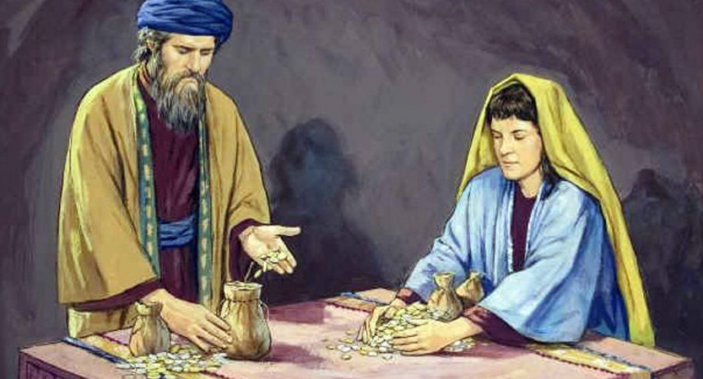
Considere el Papel de Satanás
Llenando nuestros corazones de maldad por nuestra propia voluntad
Santiago 1: 13-15 RVR60 Que nadie diga cuando es tentado: Soy tentado por Dios; porque Dios no puede ser tentado por el mal, ni tampoco tienta a nadie; (14) Pero todo hombre es tentado cuando es atraído. de su propia lujuria, y seducido. (15) Entonces, cuando la concupiscencia concibe, trae el pecado; y el pecado, cuando es consumado, trae la muerte.

Slide 6

El papel adecuado de una esposa
MUJERES MALAS EN LA BIBLIA
Ayudar, alentar
Restricción
Génesis 2:18
1 Samuel 25: 32-38
SAFIRA CONTRIBUYÓ MINTIENDO
Notes:
Genesis 2:18 NIV The LORD God said, "It is not good for the man to be alone. I will make a helper suitable for him."
1 Samuel 25:32-38 NAS95 Then David said to Abigail, "Blessed be the LORD God of Israel, who sent you this day to meet me, (33) and blessed be your discernment, and blessed be you, who have kept me this day from bloodshed and from avenging myself by my own hand. (34) "Nevertheless, as the LORD God of Israel lives, who has restrained me from harming you, unless you had come quickly to meet me, surely there would not have been left to Nabal until the morning light as much as one male." (35) So David received from her hand what she had brought him and said to her, "Go up to your house in peace. See, I have listened to you and granted your request." (36) Then Abigail came to Nabal, and behold, he was holding a feast in his house, like the feast of a king. And Nabal's heart was merry within him, for he was very drunk; so she did not tell him anything at all until the morning light. (37) But in the morning, when the wine had gone out of Nabal, his wife told him these things, and his heart died within him so that he became as a stone. (38) About ten days later, the LORD struck Nabal and he died.

Slide 7
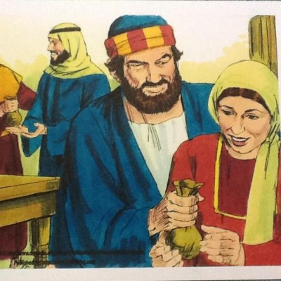
Cómo Deben ser Tratados Dios y su Espíritu
Probando la Deidad del Espíritu Santo
El Espíritu conoce nuestros pensamientos
Notes:
Acts 5:1-11 KJV But a certain man named Ananias, with Sapphira his wife, sold a possession, (2) And kept back part of the price, his wife also being privy to it, and brought a certain part, and laid it at the apostles' feet. (3) But Peter said, Ananias, why hath Satan filled thine heart to lie to the Holy Ghost, and to keep back part of the price of the land? (4) Whiles it remained, was it not thine own? and after it was sold, was it not in thine own power? why hast thou conceived this thing in thine heart? thou hast not lied unto men, but unto God. (5) And Ananias hearing these words fell down, and gave up the ghost: and great fear came on all them that heard these things. (6) And the young men arose, wound him up, and carried him out, and buried him. (7) And it was about the space of three hours after, when his wife, not knowing what was done, came in. (8) And Peter answered unto her, Tell me whether ye sold the land for so much? And she said, Yea, for so much. (9) Then Peter said unto her, How is it that ye have agreed together to tempt the Spirit of the Lord? behold, the feet of them which have buried thy husband are at the door, and shall carry thee out. (10) Then fell she down straightway at his feet, and yielded up the ghost: and the young men came in, and found her dead, and, carrying her forth, buried her by her husband. (11) And great fear came upon all the church, and upon as many as heard these things.
2 Peter 1:21 NAS95 for no prophecy was ever made by an act of human will, but men moved by the Holy Spirit spoke from God.
Luke 16:14-15 NAS95 Now the Pharisees, who were lovers of money, were listening to all these things and were scoffing at Him. (15) And He said to them, "You are those who justify yourselves in the sight of men, but God knows your hearts; for that which is highly esteemed among men is detestable in the sight of God.
Romans 8:26-27 NAS95 In the same way the Spirit also helps our weakness; for we do not know how to pray as we should, but the Spirit Himself intercedes for us with groanings too deep for words; (27) and He who searches the hearts knows what the mind of the Spirit is, because He intercedes for the saints according to the will of God.
Hebrews 4:12-13 NAS95 For the word of God is living and active and sharper than any two-edged sword, and piercing as far as the division of soul and spirit, of both joints and marrow, and able to judge the thoughts and intentions of the heart. (13) And there is no creature hidden from His sight, but all things are open and laid bare to the eyes of Him with whom we have to do.

Slide 8
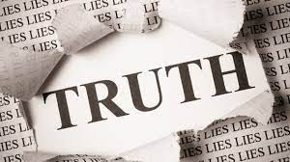
La Verdad Debe ser Central en Nuestras Vidas
Es real, absoluta y aplicable.
3 Juan 1: 4 RV No tengo mayor gozo que escuchar que mis hijos andan en la verdad.
1 Juan 3: 18-19 RV Hijitos míos, no amemos de palabra ni de lengua; pero de hecho y en verdad. (19) Y en esto sabemos que somos de la verdad, y aseguraremos nuestro corazón delante de él.
1 Timoteo 6: 5 RVR60 Disputas perversas de hombres de mente corrupta y desprovistos de la verdad, pensando que la ganancia es piedad; apártate de los tales.
VERDAD
Notes:
Ephesians 4:22-25 KJV That ye put off concerning the former conversation the old man, which is corrupt according to the deceitful lusts; (23) And be renewed in the spirit of your mind; (24) And that ye put on the new man, which after God is created in righteousness and true holiness. (25) Wherefore putting away lying, speak every man truth with his neighbour: for we are members one of another

Slide 9
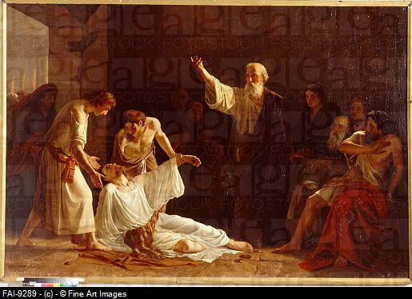
El pecado viene con consecuencias
A veces aquí, en la eternidad siempre
Notes:
Hebrews 9:27 KJV And as it is appointed unto men once to die, but after this the judgment:
Acts 17:30-31 KJV And the times of this ignorance God winked at; but now commandeth all men every where to repent: (31) Because he hath appointed a day, in the which he will judge the world in righteousness by that man whom he hath ordained; whereof he hath given assurance unto all men, in that he hath raised him from the dead.
2 Corinthians 5:9-10 KJV Wherefore we labour, that, whether present or absent, we may be accepted of him. (10) For we must all appear before the judgment seat of Christ; that every one may receive the things done in his body, according to that he hath done, whether it be good or bad.

Slide 10
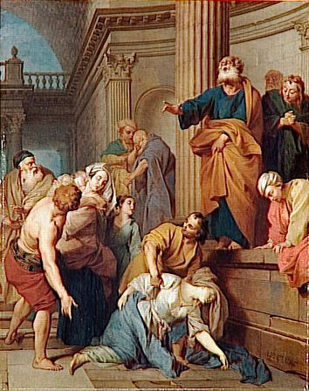
Cómo la Iglesia Debe Adorar y Trabajar
Caminando en el temor del Señor
Hechos 9:31. Entonces las iglesias reposaron en toda Judea, Galilea y Samaria, y fueron edificadas; y andando en el temor del Señor y en el consuelo del Espíritu Santo, se multiplicaron.
Notes:
Acts 5:1-11 KJV But a certain man named Ananias, with Sapphira his wife, sold a possession, (2) And kept back part of the price, his wife also being privy to it, and brought a certain part, and laid it at the apostles' feet. (3) But Peter said, Ananias, why hath Satan filled thine heart to lie to the Holy Ghost, and to keep back part of the price of the land? (4) Whiles it remained, was it not thine own? and after it was sold, was it not in thine own power? why hast thou conceived this thing in thine heart? thou hast not lied unto men, but unto God. (5) And Ananias hearing these words fell down, and gave up the ghost: and great fear came on all them that heard these things. (6) And the young men arose, wound him up, and carried him out, and buried him. (7) And it was about the space of three hours after, when his wife, not knowing what was done, came in. (8) And Peter answered unto her, Tell me whether ye sold the land for so much? And she said, Yea, for so much. (9) Then Peter said unto her, How is it that ye have agreed together to tempt the Spirit of the Lord? behold, the feet of them which have buried thy husband are at the door, and shall carry thee out. (10) Then fell she down straightway at his feet, and yielded up the ghost: and the young men came in, and found her dead, and, carrying her forth, buried her by her husband. (11) And great fear came upon all the church, and upon as many as heard these things.
Acts 9:31 KJV Then had the churches rest throughout all Judaea and Galilee and Samaria, and were edified; and walking in the fear of the Lord, and in the comfort of the Holy Ghost, were multiplied.

Slide 11
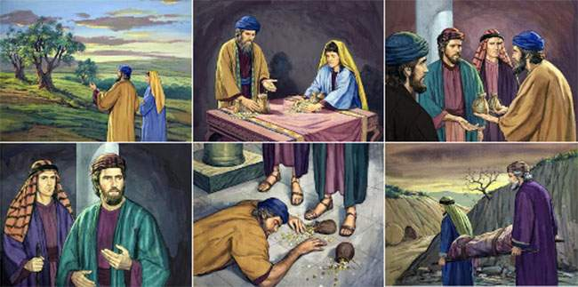
Las Oportunidades que Tenemos
La bendición del arrepentimiento
Hechos 2: 37-38. Cuando oyeron esto, se compungieron de corazón y dijeron a Pedro y a los demás apóstoles: Varones hermanos, ¿qué haremos? (38) Entonces Pedro les dijo: Arrepentíos y bautícese cada uno de vosotros en el nombre de Jesucristo para remisión de los pecados, y recibiréis el don del Espíritu Santo.
Hechos 11: 17-18 RV Por cuanto Dios les dio el mismo regalo que a nosotros, que creímos en el Señor Jesucristo; ¿Qué era yo, que podía resistir a Dios? (18) Cuando oyeron estas cosas, callaron y glorificaron a Dios, diciendo: Entonces Dios también a los gentiles ha dado arrepentimiento para vida.
Notes:
Luke 24:46-49 KJV And said unto them, Thus it is written, and thus it behoved Christ to suffer, and to rise from the dead the third day: (47) And that repentance and remission of sins should be preached in his name among all nations, beginning at Jerusalem. (48) And ye are witnesses of these things. (49) And, behold, I send the promise of my Father upon you: but tarry ye in the city of Jerusalem, until ye be endued with power from on high.
Matthew 9:13 KJV But go ye and learn what that meaneth, I will have mercy, and not sacrifice: for I am not come to call the righteous, but sinners to repentance.
2 Corinthians 7:8-11 KJV For though I made you sorry with a letter, I do not repent, though I did repent: for I perceive that the same epistle hath made you sorry, though it were but for a season. (9) Now I rejoice, not that ye were made sorry, but that ye sorrowed to repentance: for ye were made sorry after a godly manner, that ye might receive damage by us in nothing. (10) For godly sorrow worketh repentance to salvation not to be repented of: but the sorrow of the world worketh death. (11) For behold this selfsame thing, that ye sorrowed after a godly sort, what carefulness it wrought in you, yea, what clearing of yourselves, yea, what indignation, yea, what fear, yea, what vehement desire, yea, what zeal, yea, what revenge! In all things ye have approved yourselves to be clear in this matter.

