Slide 1
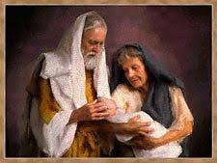
CREER LO INCREÍBLE
Genesis 17-18

Slide 2
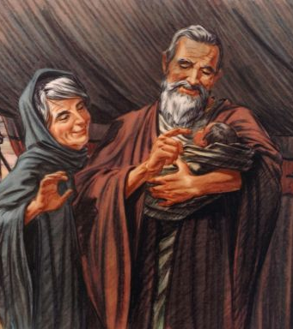
Es Bastante Difícil De Creer
Dios creó la tierra en 7 días
Dios inundó toda la tierra con agua
El Mar Rojo se dividió para que los israelitas pudieran escapar.
Joshua alargó un día levantando las manos
El reloj de sol retrocedió para Ezequías
Jesús nació de una virgen
Jesús alimentó a miles con solo unos pocos panes y peces
Jesús resucitó de entre los muertos
Jesús era el Hijo de Dios

Slide 3
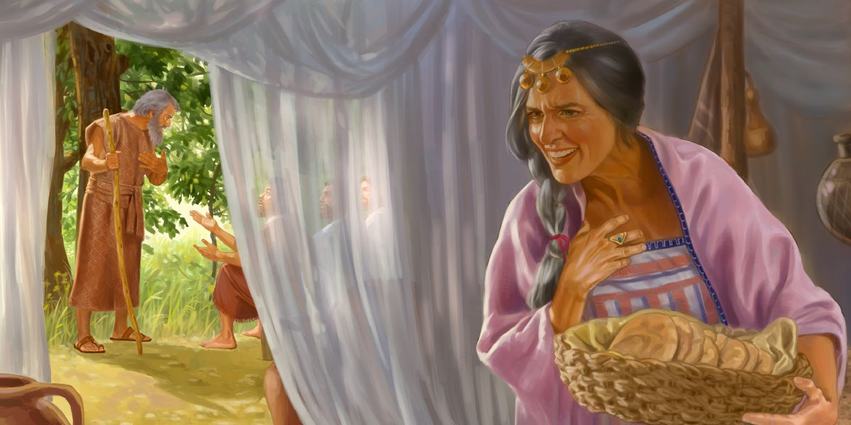
Abraham y Sara También Tenían Dificultades
Genesis 17:15-22
Genesis 18:9-15
Fue fantástico
¿Nos has visto?
  Hebreos 11: 11-12
Todavía no ha sucedido
  Génesis 15: 1-4
Notes:
Genesis 17:15-22 KJV And God said unto Abraham, As for Sarai thy wife, thou shalt not call her name Sarai, but Sarah shall her name be. (16) And I will bless her, and give thee a son also of her: yea, I will bless her, and she shall be a mother of nations; kings of people shall be of her. (17) Then Abraham fell upon his face, and laughed, and said in his heart, Shall a child be born unto him that is an hundred years old? and shall Sarah, that is ninety years old, bear? (18) And Abraham said unto God, O that Ishmael might live before thee! (19) And God said, Sarah thy wife shall bear thee a son indeed; and thou shalt call his name Isaac: and I will establish my covenant with him for an everlasting covenant, and with his seed after him. (20) And as for Ishmael, I have heard thee: Behold, I have blessed him, and will make him fruitful, and will multiply him exceedingly; twelve princes shall he beget, and I will make him a great nation. (21) But my covenant will I establish with Isaac, which Sarah shall bear unto thee at this set time in the next year. (22) And he left off talking with him, and God went up from Abraham.
Genesis 18:9-15 KJV And they said unto him, Where is Sarah thy wife? And he said, Behold, in the tent. (10) And he said, I will certainly return unto thee according to the time of life; and, lo, Sarah thy wife shall have a son. And Sarah heard it in the tent door, which was behind him. (11) Now Abraham and Sarah were old and well stricken in age; and it ceased to be with Sarah after the manner of women. (12) Therefore Sarah laughed within herself, saying, After I am waxed old shall I have pleasure, my lord being old also? (13) And the LORD said unto Abraham, Wherefore did Sarah laugh, saying, Shall I of a surety bear a child, which am old? (14) Is any thing too hard for the LORD? At the time appointed I will return unto thee, according to the time of life, and Sarah shall have a son. (15) Then Sarah denied, saying, I laughed not; for she was afraid. And he said, Nay; but thou didst laugh.
Hebrews 11:11-12 KJV Through faith also Sara herself received strength to conceive seed, and was delivered of a child when she was past age, because she judged him faithful who had promised. (12) Therefore sprang there even of one, and him as good as dead, so many as the stars of the sky in multitude, and as the sand which is by the sea shore innumerable.
Genesis 15:1-4 KJV After these things the word of the LORD came unto Abram in a vision, saying, Fear not, Abram: I am thy shield, and thy exceeding great reward. (2) And Abram said, Lord GOD, what wilt thou give me, seeing I go childless, and the steward of my house is this Eliezer of Damascus? (3) And Abram said, Behold, to me thou hast given no seed: and, lo, one born in my house is mine heir. (4) And, behold, the word of the LORD came unto him, saying, This shall not be thine heir; but he that shall come forth out of thine own bowels shall be thine heir.

Slide 4
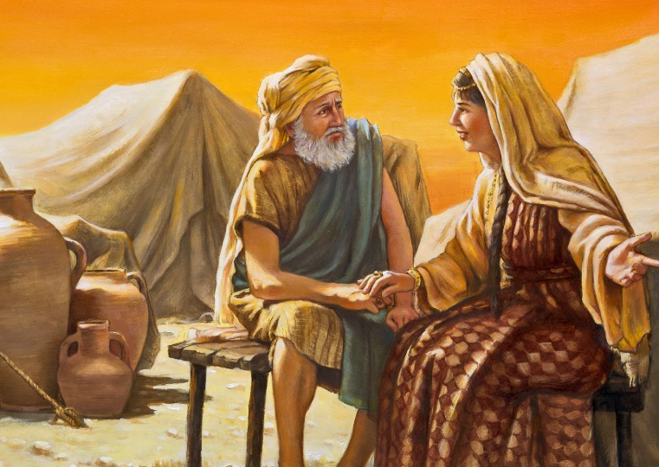
¿Qué Sucede Cuando No Creemos?
Contamos mentiras sin confiar en que Dios se preocupará por nosotros
  Génesis 12: 10-20
Usan su propia sabiduría para tratar de cumplir lo que Dios nos ha prometido.
  Génesis 16
Llevan a otras personas a su pecado y sus castigos.
  Faraón
  Sarah
  Agar
  Ismael
  Abimelec

Slide 5
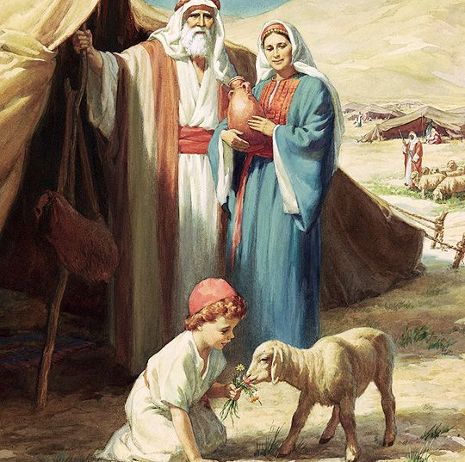
Abraham Aprendió a Creer en Dios
Ofreció a Isaac
  Génesis 22
Sara recibió fuerza a través de la fe
  Hebreos 11: 11-12
Dios lo había hecho antes
  Él devolvió la vida a los muertos
  Romanos 4: 17-21
  Hebreos 11: 17-19
La promesa se había hecho
Dios tendría que cumplir de alguna manera
Nada es demasiado difícil para dios
  Génesis 18: 13-14
  Lucas 1: 34-38
  San Mateo 19:26
  Jeremías 32:17
  Isaías 55: 8-11
Notes:
Genesis 22:9-18 KJV And they came to the place which God had told him of; and Abraham built an altar there, and laid the wood in order, and bound Isaac his son, and laid him on the altar upon the wood. (10) And Abraham stretched forth his hand, and took the knife to slay his son. (11) And the angel of the LORD called unto him out of heaven, and said, Abraham, Abraham: and he said, Here am I. (12) And he said, Lay not thine hand upon the lad, neither do thou any thing unto him: for now I know that thou fearest God, seeing thou hast not withheld thy son, thine only son from me. (13) And Abraham lifted up his eyes, and looked, and behold behind him a ram caught in a thicket by his horns: and Abraham went and took the ram, and offered him up for a burnt offering in the stead of his son. (14) And Abraham called the name of that place Jehovahjireh: as it is said to this day, In the mount of the LORD it shall be seen. (15) And the angel of the LORD called unto Abraham out of heaven the second time, (16) And said, By myself have I sworn, saith the LORD, for because thou hast done this thing, and hast not withheld thy son, thine only son: (17) That in blessing I will bless thee, and in multiplying I will multiply thy seed as the stars of the heaven, and as the sand which is upon the sea shore; and thy seed shall possess the gate of his enemies; (18) And in thy seed shall all the nations of the earth be blessed; because thou hast obeyed my voice.
Hebrews 11:17-19 KJV By faith Abraham, when he was tried, offered up Isaac: and he that had received the promises offered up his only begotten son, (18) Of whom it was said, That in Isaac shall thy seed be called: (19) Accounting that God was able to raise him up, even from the dead; from whence also he received him in a figure.
Hebrews 11:11-12 KJV Through faith also Sara herself received strength to conceive seed, and was delivered of a child when she was past age, because she judged him faithful who had promised. (12) Therefore sprang there even of one, and him as good as dead, so many as the stars of the sky in multitude, and as the sand which is by the sea shore innumerable.
Romans 4:17-21 KJV (As it is written, I have made thee a father of many nations,) before him whom he believed, even God, who quickeneth the dead, and calleth those things which be not as though they were. (18) Who against hope believed in hope, that he might become the father of many nations, according to that which was spoken, So shall thy seed be. (19) And being not weak in faith, he considered not his own body now dead, when he was about an hundred years old, neither yet the deadness of Sara's womb: (20) He staggered not at the promise of God through unbelief; but was strong in faith, giving glory to God; (21) And being fully persuaded that, what he had promised, he was able also to perform.
Hebrews 11:17-19 KJV By faith Abraham, when he was tried, offered up Isaac: and he that had received the promises offered up his only begotten son, (18) Of whom it was said, That in Isaac shall thy seed be called: (19) Accounting that God was able to raise him up, even from the dead; from whence also he received him in a figure.
Genesis 18:13-14 KJV And the LORD said unto Abraham, Wherefore did Sarah laugh, saying, Shall I of a surety bear a child, which am old? (14) Is any thing too hard for the LORD? At the time appointed I will return unto thee, according to the time of life, and Sarah shall have a son.
Luke 1:34-38 KJV Then said Mary unto the angel, How shall this be, seeing I know not a man? (35) And the angel answered and said unto her, The Holy Ghost shall come upon thee, and the power of the Highest shall overshadow thee: therefore also that holy thing which shall be born of thee shall be called the Son of God. (36) And, behold, thy cousin Elisabeth, she hath also conceived a son in her old age: and this is the sixth month with her, who was called barren. (37) For with God nothing shall be impossible. (38) And Mary said, Behold the handmaid of the Lord; be it unto me according to thy word. And the angel departed from her.
Matthew 19:26 KJV But Jesus beheld them, and said unto them, With men this is impossible; but with God all things are possible.
Jeremiah 32:17 KJV Ah Lord GOD! behold, thou hast made the heaven and the earth by thy great power and stretched out arm, and there is nothing too hard for thee:
Isaiah 55:8-11 KJV For my thoughts are not your thoughts, neither are your ways my ways, saith the LORD. (9) For as the heavens are higher than the earth, so are my ways higher than your ways, and my thoughts than your thoughts. (10) For as the rain cometh down, and the snow from heaven, and returneth not thither, but watereth the earth, and maketh it bring forth and bud, that it may give seed to the sower, and bread to the eater: (11) So shall my word be that goeth forth out of my mouth: it shall not return unto me void, but it shall accomplish that which I please, and it shall prosper in the thing whereto I sent it.

Slide 6
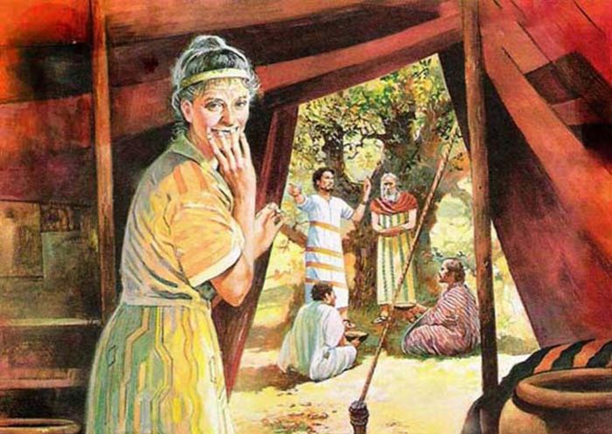
Algunos Solo Creerán si lo Ven Por sí Mismos
Jn 20:25
Rom 10:17
Jn 20:30-31
Notes:
John 20:24-30 KJV But Thomas, one of the twelve, called Didymus, was not with them when Jesus came. (25) The other disciples therefore said unto him, We have seen the Lord. But he said unto them, Except I shall see in his hands the print of the nails, and put my finger into the print of the nails, and thrust my hand into his side, I will not believe. (26) And after eight days again his disciples were within, and Thomas with them: then came Jesus, the doors being shut, and stood in the midst, and said, Peace be unto you. (27) Then saith he to Thomas, Reach hither thy finger, and behold my hands; and reach hither thy hand, and thrust it into my side: and be not faithless, but believing. (28) And Thomas answered and said unto him, My Lord and my God. (29) Jesus saith unto him, Thomas, because thou hast seen me, thou hast believed: blessed are they that have not seen, and yet have believed. (30) And many other signs truly did Jesus in the presence of his disciples, which are not written in this book:
Romans 10:17 KJV So then faith cometh by hearing, and hearing by the word of God.
John 20:30-31 KJV And many other signs truly did Jesus in the presence of his disciples, which are not written in this book: (31) But these are written, that ye might believe that Jesus is the Christ, the Son of God; and that believing ye might have life through his name.

Slide 7
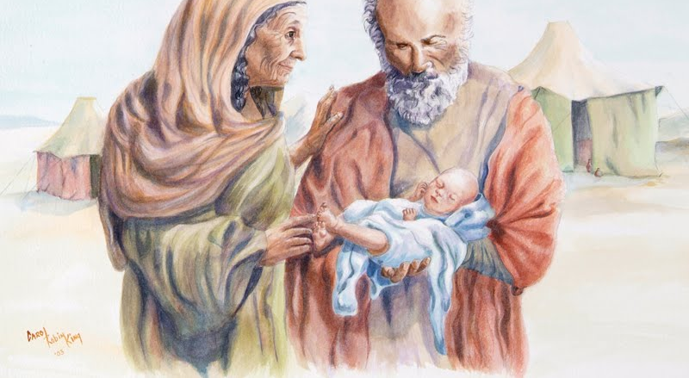
Somos Los Hijos de la Promesa
Gal 4:22-31
Isaias 54:1
Notes:
Galatians 4:22-31 KJV For it is written, that Abraham had two sons, the one by a bondmaid, the other by a freewoman. (23) But he who was of the bondwoman was born after the flesh; but he of the freewoman was by promise. (24) Which things are an allegory: for these are the two covenants; the one from the mount Sinai, which gendereth to bondage, which is Agar. (25) For this Agar is mount Sinai in Arabia, and answereth to Jerusalem which now is, and is in bondage with her children. (26) But Jerusalem which is above is free, which is the mother of us all. (27) For it is written, Rejoice, thou barren that bearest not; break forth and cry, thou that travailest not: for the desolate hath many more children than she which hath an husband. (28) Now we, brethren, as Isaac was, are the children of promise. (29) But as then he that was born after the flesh persecuted him that was born after the Spirit, even so it is now. (30) Nevertheless what saith the scripture? Cast out the bondwoman and her son: for the son of the bondwoman shall not be heir with the son of the freewoman. (31) So then, brethren, we are not children of the bondwoman, but of the free.
Isaiah 54:1 KJV Sing, O barren, thou that didst not bear; break forth into singing, and cry aloud, thou that didst not travail with child: for more are the children of the desolate than the children of the married wife, saith the LORD.

