Slide 1
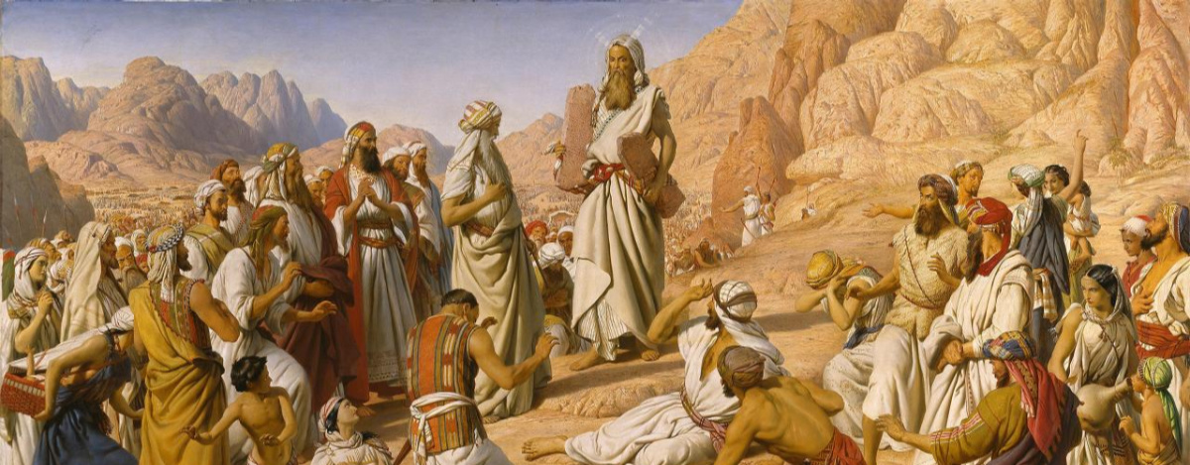
Entonces, ¿Qué es la ley?
Gal 3:19
Notes:
Galatians 3:15-22 KJV Brethren, I speak after the manner of men; Though it be but a man's covenant, yet if it be confirmed, no man disannulleth, or addeth thereto. (16) Now to Abraham and his seed were the promises made. He saith not, And to seeds, as of many; but as of one, And to thy seed, which is Christ. (17) And this I say, that the covenant, that was confirmed before of God in Christ, the law, which was four hundred and thirty years after, cannot disannul, that it should make the promise of none effect. (18) For if the inheritance be of the law, it is no more of promise: but God gave it to Abraham by promise. (19) Wherefore then serveth the law? It was added because of transgressions, till the seed should come to whom the promise was made; and it was ordained by angels in the hand of a mediator. (20) Now a mediator is not a mediator of one, but God is one. (21) Is the law then against the promises of God? God forbid: for if there had been a law given which could have given life, verily righteousness should have been by the law. (22) But the scripture hath concluded all under sin, that the promise by faith of Jesus Christ might be given to them that believe.

Slide 2
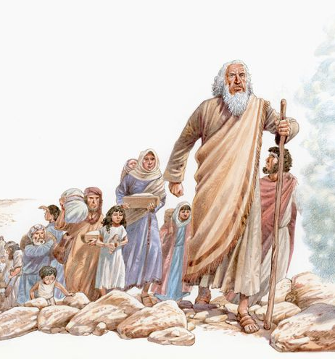
Introducción:
Esta es una lección sobre la importancia y el papel del Antiguo Testamento.
Los mandamientos del Antiguo Testamento no son nuestros mandamientos
Sin embargo, el Antiguo Testamento tiene un lugar en nuestro estudio

Slide 3
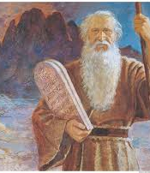
Adición a la Promesa Abrahámica-Gálatas 3:17-
La ley fue dada 430 años después de la promesa a Abraham.
No anula ni reemplaza la promesa
Fue agregado debido a las transgresiones-versículo 19
Para durar hasta la venida de Cristo-versículo 19
No podía dar vida-Versículo 21
Concluyó todo bajo pecado-Versículo 22
Notes:
Galatians 3:15-22 KJV Brethren, I speak after the manner of men; Though it be but a man's covenant, yet if it be confirmed, no man disannulleth, or addeth thereto. (16) Now to Abraham and his seed were the promises made. He saith not, And to seeds, as of many; but as of one, And to thy seed, which is Christ. (17) And this I say, that the covenant, that was confirmed before of God in Christ, the law, which was four hundred and thirty years after, cannot disannul, that it should make the promise of none effect. (18) For if the inheritance be of the law, it is no more of promise: but God gave it to Abraham by promise. (19) Wherefore then serveth the law? It was added because of transgressions, till the seed should come to whom the promise was made; and it was ordained by angels in the hand of a mediator. (20) Now a mediator is not a mediator of one, but God is one. (21) Is the law then against the promises of God? God forbid: for if there had been a law given which could have given life, verily righteousness should have been by the law. (22) But the scripture hath concluded all under sin, that the promise by faith of Jesus Christ might be given to them that believe.

Slide 4
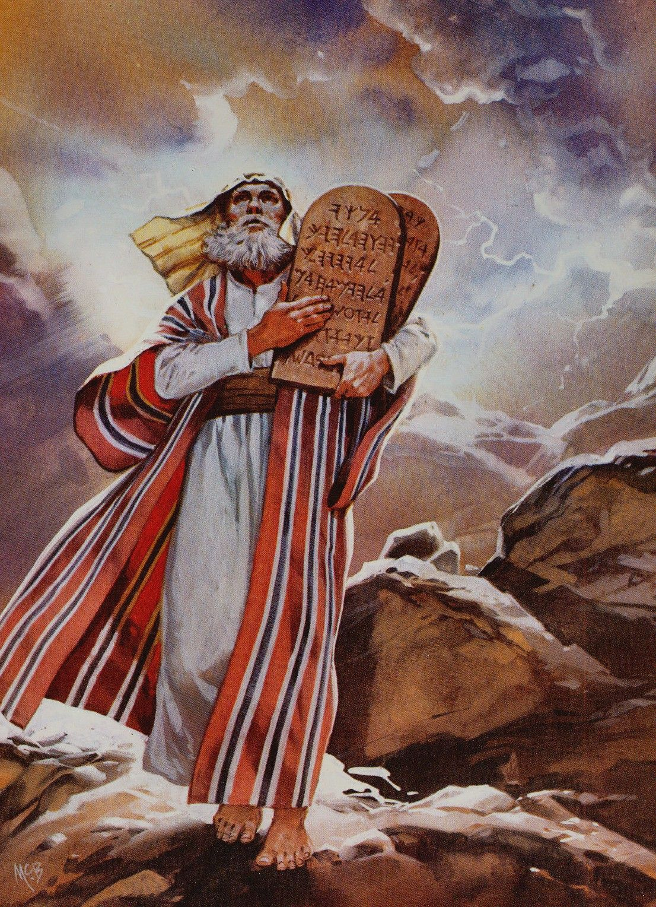
Maestro de Escuela-Gálatas 3:24
Ilustración de pedagogo,
Sirviente, tutor, trayendo hijos de padres a maestros
Liberar la custodia al maestro
Ley trayendo a Cristo
Aplicado a los judíos, y para esa dispensación
Ya no bajo un maestro de escuela-verso 25
Notes:
Galatians 3:23-25 KJV But before faith came, we were kept under the law, shut up unto the faith which should afterwards be revealed. (24) Wherefore the law was our schoolmaster to bring us unto Christ, that we might be justified by faith. (25) But after that faith is come, we are no longer under a schoolmaster.

Slide 5
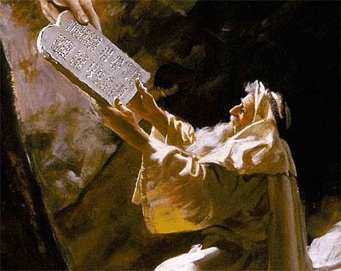
Testimonio de Cristo y Justicia - Romanos 3: 21-22
Testifica de Cristo
Juan 5: 39-40; 46
Testifica de su muerte, sepultura, resurrección y la predicación del arrepentimiento
Lucas 24: 44-49
Escuchar lo que dice Cristo
Hechos 3: 22-23
Notes:
John 5:39-40 KJV Search the scriptures; for in them ye think ye have eternal life: and they are they which testify of me. (40) And ye will not come to me, that ye might have life.
John 5:46 KJV For had ye believed Moses, ye would have believed me: for he wrote of me.
Luke 24:44-49 KJV And he said unto them, These are the words which I spake unto you, while I was yet with you, that all things must be fulfilled, which were written in the law of Moses, and in the prophets, and in the psalms, concerning me. (45) Then opened he their understanding, that they might understand the scriptures, (46) And said unto them, Thus it is written, and thus it behoved Christ to suffer, and to rise from the dead the third day: (47) And that repentance and remission of sins should be preached in his name among all nations, beginning at Jerusalem. (48) And ye are witnesses of these things. (49) And, behold, I send the promise of my Father upon you: but tarry ye in the city of Jerusalem, until ye be endued with power from on high.
Acts 3:22-26 KJV For Moses truly said unto the fathers, A prophet shall the Lord your God raise up unto you of your brethren, like unto me; him shall ye hear in all things whatsoever he shall say unto you. (23) And it shall come to pass, that every soul, which will not hear that prophet, shall be destroyed from among the people. (24) Yea, and all the prophets from Samuel and those that follow after, as many as have spoken, have likewise foretold of these days. (25) Ye are the children of the prophets, and of the covenant which God made with our fathers, saying unto Abraham, And in thy seed shall all the kindreds of the earth be blessed. (26) Unto you first God, having raised up his Son Jesus, sent him to bless you, in turning away every one of you from his iniquities.

Slide 6
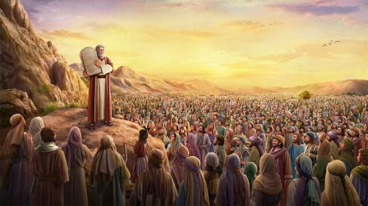
Para nuestro aprendizaje Romanos 15: 4
Paciencia, consuelo y esperanza
Ejemplos de desobediencia y resultados
1 Corintios 10: 11-12
Hebreos 10: 28-31
Entender la poderosa palabra y obra de Dios
Hebreos 11: 3; 1: 2
Salmos 33: 6; 9
2 Pedro 3: 5
Notes:
Romans 15:4 KJV For whatsoever things were written aforetime were written for our learning, that we through patience and comfort of the scriptures might have hope.
1 Corinthians 10:11-12 KJV Now all these things happened unto them for ensamples: and they are written for our admonition, upon whom the ends of the world are come. (12) Wherefore let him that thinketh he standeth take heed lest he fall.
Hebrews 10:28-31 KJV He that despised Moses' law died without mercy under two or three witnesses: (29) Of how much sorer punishment, suppose ye, shall he be thought worthy, who hath trodden under foot the Son of God, and hath counted the blood of the covenant, wherewith he was sanctified, an unholy thing, and hath done despite unto the Spirit of grace? (30) For we know him that hath said, Vengeance belongeth unto me, I will recompense, saith the Lord. And again, The Lord shall judge his people. (31) It is a fearful thing to fall into the hands of the living God.
Hebrews 11:3 KJV Through faith we understand that the worlds were framed by the word of God, so that things which are seen were not made of things which do appear.
Hebrews 1:1-2 KJV God, who at sundry times and in divers manners spake in time past unto the fathers by the prophets, (2) Hath in these last days spoken unto us by his Son, whom he hath appointed heir of all things, by whom also he made the worlds;
Psalms 33:6-9 KJV By the word of the LORD were the heavens made; and all the host of them by the breath of his mouth. (7) He gathereth the waters of the sea together as an heap: he layeth up the depth in storehouses. (8) Let all the earth fear the LORD: let all the inhabitants of the world stand in awe of him. (9) For he spake, and it was done; he commanded, and it stood fast.
2 Peter 3:5 KJV For this they willingly are ignorant of, that by the word of God the heavens were of old, and the earth standing out of the water and in the water:

Slide 7
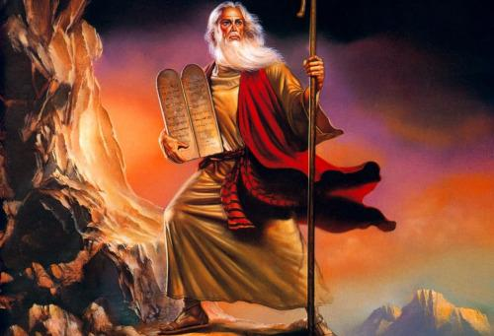
Conclusión
Debemos creer y obedecer a Cristo
Debemos vivir por el nuevo pacto
Hebreos 10: 19-23
Gálatas 3: 8-9; 13-14; 26-29
Notes:
Hebrews 10:19-23 KJV Having therefore, brethren, boldness to enter into the holiest by the blood of Jesus, (20) By a new and living way, which he hath consecrated for us, through the veil, that is to say, his flesh; (21) And having an high priest over the house of God; (22) Let us draw near with a true heart in full assurance of faith, having our hearts sprinkled from an evil conscience, and our bodies washed with pure water. (23) Let us hold fast the profession of our faith without wavering; (for he is faithful that promised;)
Galatians 3:8-9 KJV And the scripture, foreseeing that God would justify the heathen through faith, preached before the gospel unto Abraham, saying, In thee shall all nations be blessed. (9) So then they which be of faith are blessed with faithful Abraham.
Galatians 3:13-14 KJV Christ hath redeemed us from the curse of the law, being made a curse for us: for it is written, Cursed is every one that hangeth on a tree: (14) That the blessing of Abraham might come on the Gentiles through Jesus Christ; that we might receive the promise of the Spirit through faith.
Galatians 3:26-29 KJV For ye are all the children of God by faith in Christ Jesus. (27) For as many of you as have been baptized into Christ have put on Christ. (28) There is neither Jew nor Greek, there is neither bond nor free, there is neither male nor female: for ye are all one in Christ Jesus. (29) And if ye be Christ's, then are ye Abraham's seed, and heirs according to the promise.

