Slide 1
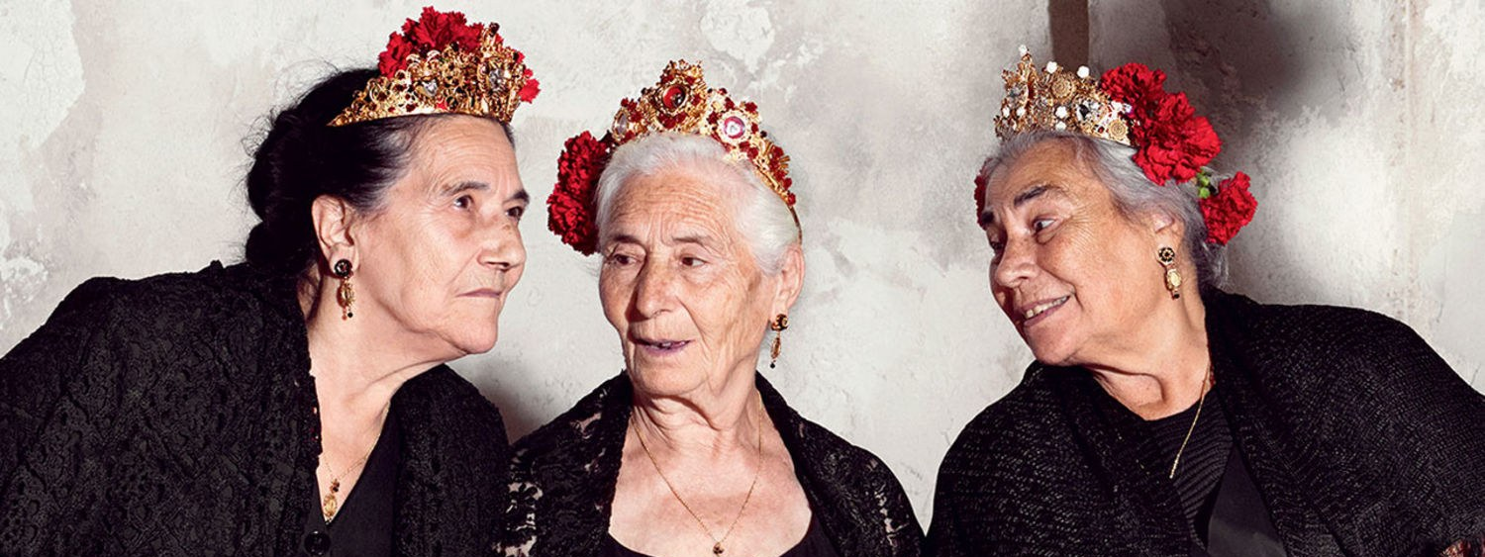
Tres Mujeres

Slide 2
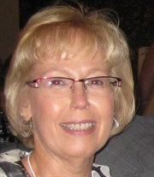
Ha sido una semana difícil Jane Curry

Slide 3
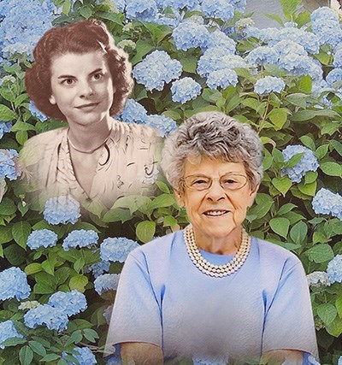
Ha sido una semana difícil Mary Walker

Slide 4
Ha sido una semana difícil Debbie Barkus
???
Notes:
Four children- Prositutes
First husband murdered
Second husband –Jimmie Hines
Left him for relationship with a woman
Third Husband in jail for trying to kill her
Foursth husband ?????

Slide 5
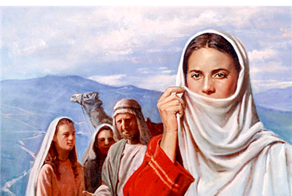
Tres Mujeres en la Biblia

Slide 6
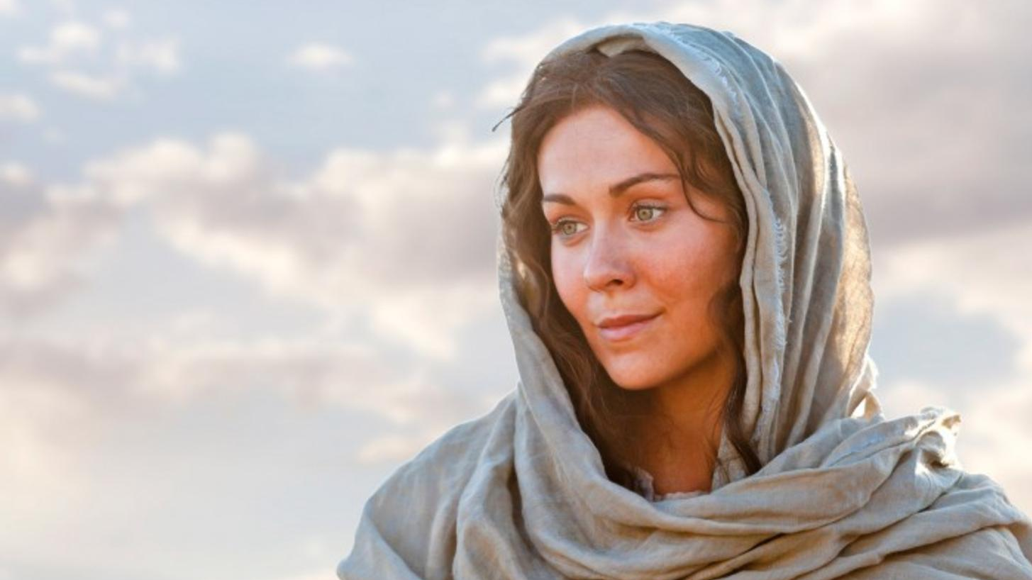
María la Madre de Jesús
Humilde
Sin miedo
Fiel
Una buena maestra
Feliz
Valiente
Dispuesta a perder
Una madre su mayor privilegio.
Notes:
Luke 1:26-38 KJV And in the sixth month the angel Gabriel was sent from God unto a city of Galilee, named Nazareth, (27) To a virgin espoused to a man whose name was Joseph, of the house of David; and the virgin's name was Mary. (28) And the angel came in unto her, and said, Hail, thou that art highly favoured, the Lord is with thee: blessed art thou among women. (29) And when she saw him, she was troubled at his saying, and cast in her mind what manner of salutation this should be. (30) And the angel said unto her, Fear not, Mary: for thou hast found favour with God. (31) And, behold, thou shalt conceive in thy womb, and bring forth a son, and shalt call his name JESUS. (32) He shall be great, and shall be called the Son of the Highest: and the Lord God shall give unto him the throne of his father David: (33) And he shall reign over the house of Jacob for ever; and of his kingdom there shall be no end. (34) Then said Mary unto the angel, How shall this be, seeing I know not a man? (35) And the angel answered and said unto her, The Holy Ghost shall come upon thee, and the power of the Highest shall overshadow thee: therefore also that holy thing which shall be born of thee shall be called the Son of God. (36) And, behold, thy cousin Elisabeth, she hath also conceived a son in her old age: and this is the sixth month with her, who was called barren. (37) For with God nothing shall be impossible. (38) And Mary said, Behold the handmaid of the Lord; be it unto me according to thy word. And the angel departed from her.
Luke 1:46-56 KJV And Mary said, My soul doth magnify the Lord, (47) And my spirit hath rejoiced in God my Saviour. (48) For he hath regarded the low estate of his handmaiden: for, behold, from henceforth all generations shall call me blessed. (49) For he that is mighty hath done to me great things; and holy is his name. (50) And his mercy is on them that fear him from generation to generation. (51) He hath shewed strength with his arm; he hath scattered the proud in the imagination of their hearts. (52) He hath put down the mighty from their seats, and exalted them of low degree. (53) He hath filled the hungry with good things; and the rich he hath sent empty away. (54) He hath holpen his servant Israel, in remembrance of his mercy; (55) As he spake to our fathers, to Abraham, and to his seed for ever. (56) And Mary abode with her about three months, and returned to her own house.
Luke 2:39-40 KJV And when they had performed all things according to the law of the Lord, they returned into Galilee, to their own city Nazareth. (40) And the child grew, and waxed strong in spirit, filled with wisdom: and the grace of God was upon him.
Luke 2:48-52 KJV And when they saw him, they were amazed: and his mother said unto him, Son, why hast thou thus dealt with us? behold, thy father and I have sought thee sorrowing. (49) And he said unto them, How is it that ye sought me? wist ye not that I must be about my Father's business? (50) And they understood not the saying which he spake unto them. (51) And he went down with them, and came to Nazareth, and was subject unto them: but his mother kept all these sayings in her heart. (52) And Jesus increased in wisdom and stature, and in favour with God and man.
John 19:25-27 KJV Now there stood by the cross of Jesus his mother, and his mother's sister, Mary the wife of Cleophas, and Mary Magdalene. (26) When Jesus therefore saw his mother, and the disciple standing by, whom he loved, he saith unto his mother, Woman, behold thy son! (27) Then saith he to the disciple, Behold thy mother! And from that hour that disciple took her unto his own home.
Acts 1:14 KJV These all continued with one accord in prayer and supplication, with the women, and Mary the mother of Jesus, and with his brethren.

Slide 7
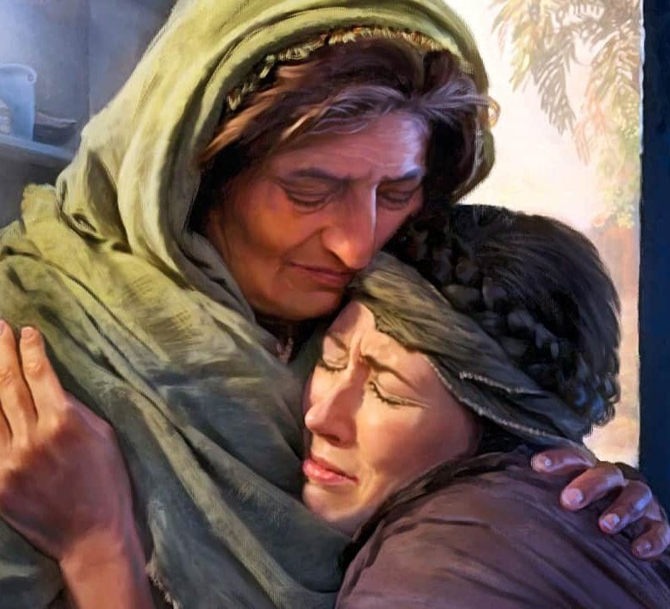
Ruth la Moabita
Viuda
Sin hijos
Una forastera
Leal en el amor
Compartiendo las penurias y bendiciones de la vida
Diligente en el trabajo
No tengo miedo de ser pobre
Bendecida en el matrimonio y en el linaje del Señor
Notes:
Ruth 1:1-22 KJV Now it came to pass in the days when the judges ruled, that there was a famine in the land. And a certain man of Bethlehemjudah went to sojourn in the country of Moab, he, and his wife, and his two sons. (2) And the name of the man was Elimelech, and the name of his wife Naomi, and the name of his two sons Mahlon and Chilion, Ephrathites of Bethlehemjudah. And they came into the country of Moab, and continued there. (3) And Elimelech Naomi's husband died; and she was left, and her two sons. (4) And they took them wives of the women of Moab; the name of the one was Orpah, and the name of the other Ruth: and they dwelled there about ten years. (5) And Mahlon and Chilion died also both of them; and the woman was left of her two sons and her husband. (6) Then she arose with her daughters in law, that she might return from the country of Moab: for she had heard in the country of Moab how that the LORD had visited his people in giving them bread. (7) Wherefore she went forth out of the place where she was, and her two daughters in law with her; and they went on the way to return unto the land of Judah. (8) And Naomi said unto her two daughters in law, Go, return each to her mother's house: the LORD deal kindly with you, as ye have dealt with the dead, and with me. (9) The LORD grant you that ye may find rest, each of you in the house of her husband. Then she kissed them; and they lifted up their voice, and wept. (10) And they said unto her, Surely we will return with thee unto thy people. (11) And Naomi said, Turn again, my daughters: why will ye go with me? are there yet any more sons in my womb, that they may be your husbands? (12) Turn again, my daughters, go your way; for I am too old to have an husband. If I should say, I have hope, if I should have an husband also to night, and should also bear sons; (13) Would ye tarry for them till they were grown? would ye stay for them from having husbands? nay, my daughters; for it grieveth me much for your sakes that the hand of the LORD is gone out against me. (14) And they lifted up their voice, and wept again: and Orpah kissed her mother in law; but Ruth clave unto her. (15) And she said, Behold, thy sister in law is gone back unto her people, and unto her gods: return thou after thy sister in law. (16) And Ruth said, Intreat me not to leave thee, or to return from following after thee: for whither thou goest, I will go; and where thou lodgest, I will lodge: thy people shall be my people, and thy God my God: (17) Where thou diest, will I die, and there will I be buried: the LORD do so to me, and more also, if ought but death part thee and me. (18) When she saw that she was stedfastly minded to go with her, then she left speaking unto her. (19) So they two went until they came to Bethlehem. And it came to pass, when they were come to Bethlehem, that all the city was moved about them, and they said, Is this Naomi? (20) And she said unto them, Call me not Naomi, call me Mara: for the Almighty hath dealt very bitterly with me. (21) I went out full, and the LORD hath brought me home again empty: why then call ye me Naomi, seeing the LORD hath testified against me, and the Almighty hath afflicted me? (22) So Naomi returned, and Ruth the Moabitess, her daughter in law, with her, which returned out of the country of Moab: and they came to Bethlehem in the beginning of barley harvest.
Ruth 4:9-17 KJV And Boaz said unto the elders, and unto all the people, Ye are witnesses this day, that I have bought all that was Elimelech's, and all that was Chilion's and Mahlon's, of the hand of Naomi. (10) Moreover Ruth the Moabitess, the wife of Mahlon, have I purchased to be my wife, to raise up the name of the dead upon his inheritance, that the name of the dead be not cut off from among his brethren, and from the gate of his place: ye are witnesses this day. (11) And all the people that were in the gate, and the elders, said, We are witnesses. The LORD make the woman that is come into thine house like Rachel and like Leah, which two did build the house of Israel: and do thou worthily in Ephratah, and be famous in Bethlehem: (12) And let thy house be like the house of Pharez, whom Tamar bare unto Judah, of the seed which the LORD shall give thee of this young woman. (13) So Boaz took Ruth, and she was his wife: and when he went in unto her, the LORD gave her conception, and she bare a son. (14) And the women said unto Naomi, Blessed be the LORD, which hath not left thee this day without a kinsman, that his name may be famous in Israel. (15) And he shall be unto thee a restorer of thy life, and a nourisher of thine old age: for thy daughter in law, which loveth thee, which is better to thee than seven sons, hath born him. (16) And Naomi took the child, and laid it in her bosom, and became nurse unto it. (17) And the women her neighbours gave it a name, saying, There is a son born to Naomi; and they called his name Obed: he is the father of Jesse, the father of David.

Slide 8
Jezabel
Adoradora de Dioses falsos.
Se opuso a todos y todo lo que no aceptó a sus dioses.
Manipuló a su marido.
Complació sus fantasías.
Identificada como una ramera.
Trata de seducir a Jehu
Maldita por Dios.
Muere comida por perros.
Notes:
1 Kings 16:30-33 KJV And Ahab the son of Omri did evil in the sight of the LORD above all that were before him. (31) And it came to pass, as if it had been a light thing for him to walk in the sins of Jeroboam the son of Nebat, that he took to wife Jezebel the daughter of Ethbaal king of the Zidonians, and went and served Baal, and worshipped him. (32) And he reared up an altar for Baal in the house of Baal, which he had built in Samaria. (33) And Ahab made a grove; and Ahab did more to provoke the LORD God of Israel to anger than all the kings of Israel that were before him.
1 Kings 18:1-4 KJV And it came to pass after many days, that the word of the LORD came to Elijah in the third year, saying, Go, shew thyself unto Ahab; and I will send rain upon the earth. (2) And Elijah went to shew himself unto Ahab. And there was a sore famine in Samaria. (3) And Ahab called Obadiah, which was the governor of his house. (Now Obadiah feared the LORD greatly: (4) For it was so, when Jezebel cut off the prophets of the LORD, that Obadiah took an hundred prophets, and hid them by fifty in a cave, and fed them with bread and water.)
1 Kings 19:1-2 KJV And Ahab told Jezebel all that Elijah had done, and withal how he had slain all the prophets with the sword. (2) Then Jezebel sent a messenger unto Elijah, saying, So let the gods do to me, and more also, if I make not thy life as the life of one of them by to morrow about this time.
1 Kings 21:1-7 KJV And it came to pass after these things, that Naboth the Jezreelite had a vineyard, which was in Jezreel, hard by the palace of Ahab king of Samaria. (2) And Ahab spake unto Naboth, saying, Give me thy vineyard, that I may have it for a garden of herbs, because it is near unto my house: and I will give thee for it a better vineyard than it; or, if it seem good to thee, I will give thee the worth of it in money. (3) And Naboth said to Ahab, The LORD forbid it me, that I should give the inheritance of my fathers unto thee. (4) And Ahab came into his house heavy and displeased because of the word which Naboth the Jezreelite had spoken to him: for he had said, I will not give thee the inheritance of my fathers. And he laid him down upon his bed, and turned away his face, and would eat no bread. (5) But Jezebel his wife came to him, and said unto him, Why is thy spirit so sad, that thou eatest no bread? (6) And he said unto her, Because I spake unto Naboth the Jezreelite, and said unto him, Give me thy vineyard for money; or else, if it please thee, I will give thee another vineyard for it: and he answered, I will not give thee my vineyard. (7) And Jezebel his wife said unto him, Dost thou now govern the kingdom of Israel? arise, and eat bread, and let thine heart be merry: I will give thee the vineyard of Naboth the Jezreelite.
1 Kings 21:17-19 KJV And the word of the LORD came to Elijah the Tishbite, saying, (18) Arise, go down to meet Ahab king of Israel, which is in Samaria: behold, he is in the vineyard of Naboth, whither he is gone down to possess it. (19) And thou shalt speak unto him, saying, Thus saith the LORD, Hast thou killed, and also taken possession? And thou shalt speak unto him, saying, Thus saith the LORD, In the place where dogs licked the blood of Naboth shall dogs lick thy blood, even thine.
1 Kings 21:23-24 KJV And of Jezebel also spake the LORD, saying, The dogs shall eat Jezebel by the wall of Jezreel. (24) Him that dieth of Ahab in the city the dogs shall eat; and him that dieth in the field shall the fowls of the air eat.
2 Kings 9:5-9 KJV And when he came, behold, the captains of the host were sitting; and he said, I have an errand to thee, O captain. And Jehu said, Unto which of all us? And he said, To thee, O captain. (6) And he arose, and went into the house; and he poured the oil on his head, and said unto him, Thus saith the LORD God of Israel, I have anointed thee king over the people of the LORD, even over Israel. (7) And thou shalt smite the house of Ahab thy master, that I may avenge the blood of my servants the prophets, and the blood of all the servants of the LORD, at the hand of Jezebel. (8) For the whole house of Ahab shall perish: and I will cut off from Ahab him that pisseth against the wall, and him that is shut up and left in Israel: (9) And I will make the house of Ahab like the house of Jeroboam the son of Nebat, and like the house of Baasha the son of Ahijah:
2 Kings 9:22 KJV And it came to pass, when Joram saw Jehu, that he said, Is it peace, Jehu? And he answered, What peace, so long as the whoredoms of thy mother Jezebel and her witchcrafts are so many?
2 Kings 9:30-37 KJV And when Jehu was come to Jezreel, Jezebel heard of it; and she painted her face, and tired her head, and looked out at a window. (31) And as Jehu entered in at the gate, she said, Had Zimri peace, who slew his master? (32) And he lifted up his face to the window, and said, Who is on my side? who? And there looked out to him two or three eunuchs. (33) And he said, Throw her down. So they threw her down: and some of her blood was sprinkled on the wall, and on the horses: and he trode her under foot. (34) And when he was come in, he did eat and drink, and said, Go, see now this cursed woman, and bury her: for she is a king's daughter. (35) And they went to bury her: but they found no more of her than the skull, and the feet, and the palms of her hands. (36) Wherefore they came again, and told him. And he said, This is the word of the LORD, which he spake by his servant Elijah the Tishbite, saying, In the portion of Jezreel shall dogs eat the flesh of Jezebel: (37) And the carcase of Jezebel shall be as dung upon the face of the field in the portion of Jezreel; so that they shall not say, This is Jezebel.

Slide 9
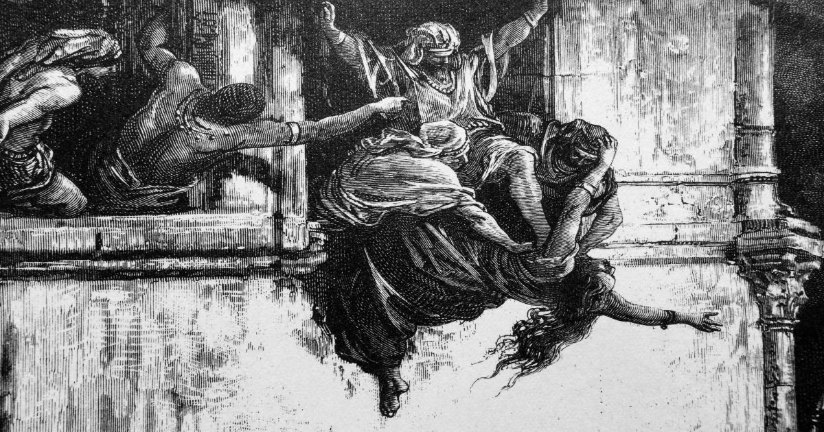
¿Cuál debería ser?

Slide 10
¿Cuál debería ser?

